Slide 1

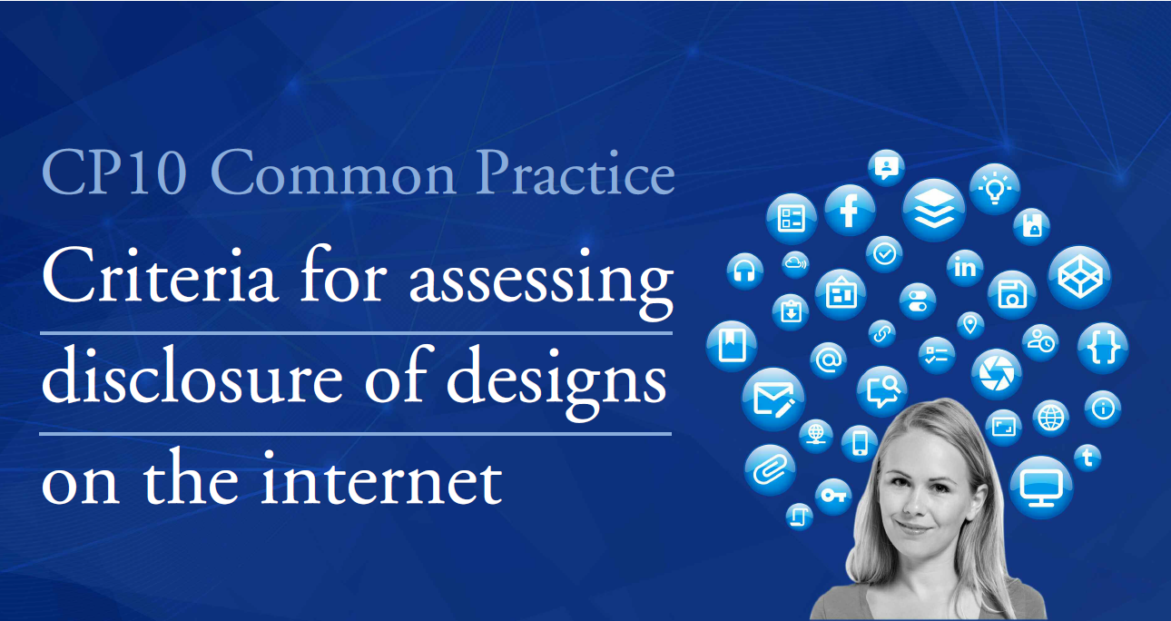
CP10: Criteria for assessing disclosure of designs on the internet

Slide 2
Convergence Project: CP10. Criteria for assessing disclosure of designs on the internet
CONVERGENCE PROJECTS

Slide 3
Convergence Project: CP10. Criteria for assessing disclosure of designs on the internet
Convergence Projects – Legal basis
EU trade mark reform package
Article 151EUTMR
Article 152 EUTMR
LoA4: Intensify Network Engagement
ECP4:
Shared Services and Practices
Subproject ECP4:
Convergence Analysis Project
EUIPO’s Strategic Plan 2020
European Cooperation Projects
Subproject ECP4:
Convergence Analysis Project

Slide 4




Convergence Project: CP10. Criteria for assessing disclosure of designs on the internet
Convergence Analysis Project
Interests
and benefits
Legal
constraints
Evaluation of impact & feasibility
Level of existing divergence

Slide 5
Convergence Project: CP10. Criteria for assessing disclosure of designs on the internet
CP10 – CRITERIA FOR ASSESSING DISCLOSURE OF DESIGNS ON THE INTERNET

Slide 6
Convergence Project: CP10. Criteria for assessing disclosure of designs on the internet
BASIS & TIMELINE
CP10 COMMON PRACTICE

Slide 7

Convergence Project: CP10. Criteria for assessing disclosure of designs on the internet
CP10: Basis
WG Members
Case-law
Existing practices
6 MS IPOs
EU judgments
General Court
Court of Justice
3 UAs
Common Practice
EUIPO
Also consulted:
EPO
Feedback
EUIPO
  First instance
  BOA
National decisions
EPO

Slide 8
Convergence Project: CP10. Criteria for assessing disclosure of designs on the internet
CP10: Project timeline
Q4 2017 | Q1 2018 | Q2 2018 | Q3 2018 | Q4 2018 | Q1 2019 | Q2 2019 | Q3 2019 | Q4 2019 | Q1 2020 | Q2 2020 | Q3 2020
Oct Nov Dec | Jan Feb Mar | Apr May Jun | Jul Aug Sep | Oct Nov Dec | Jan Feb Mar | Apr May Jun | Jul Aug Sep | Oct Nov Dec | Jan Feb Mar | Apr May Jun | Jul Aug Sep
MB
Endorsement
LM
LM
MBBC
MBBC
Plenary
LM
WG
Kick off
WG
WG
Implementation
Favourable opinion
Common Communication
CP10 Project definition adopted
Training Material
Communication Draft Common Practice on Common Gateway for EU IPO POCs
FINAL Common Practice document
WG: Working Group
Plenary: Convergence Plenary
LM: Liaison Meeting
MB: Management Board
Drafting Workshop
Release of documents
Implementation
2nd Publication of draft Common Practice document on TMDN for EU, non-EU IPOS, UAs
1st Publication of draft Common Practice document on TMDN for EU, non-EU IPOS, UAs

Slide 9
Convergence Project: CP10. Criteria for assessing disclosure of designs on the internet
BASIS & TIMELINE
CP10 COMMON PRACTICE

Slide 10

Convergence Project: CP10. Criteria for assessing disclosure of designs on the internet

Slide 11

Convergence Project: CP10. Criteria for assessing disclosure of designs on the internet
CP10: Scope of the Common Practice
Provide criteria and recommendations on:
Different sources of disclosure on the internet
Establishing the relevant date of disclosure
Means for presenting the evidence obtained from the internet
Exceptions to the availability of designs on the internet
OUT of scope
Assessment of ‘circles specialised in the sector concerned’

Slide 12
Convergence Project: CP10. Criteria for assessing disclosure of designs on the internet
CP10: Introduction – Key concepts
Two-step test: design made available to the public:
  if …
  published following registration or otherwise, or exhibited, used in trade or otherwise disclosed,
  except …
  where these events could not reasonably have become known
1
2

Slide 13
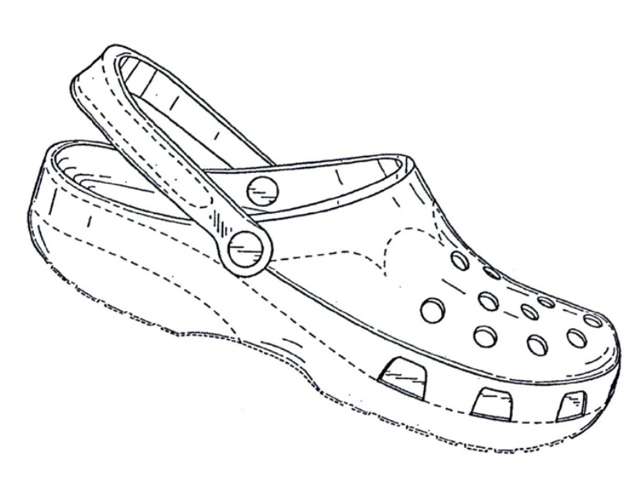
Convergence Project: CP10. Criteria for assessing disclosure of designs on the internet
CP10: Introduction – Key concepts. Relevant case-law
Disclosure outside the EU
CP10
T-651/16 of 14/03/2018 (‘Footwear’), § 48
General Court
General presumption: design made available if event of disclosure is established, unless established exceptions apply

Slide 14
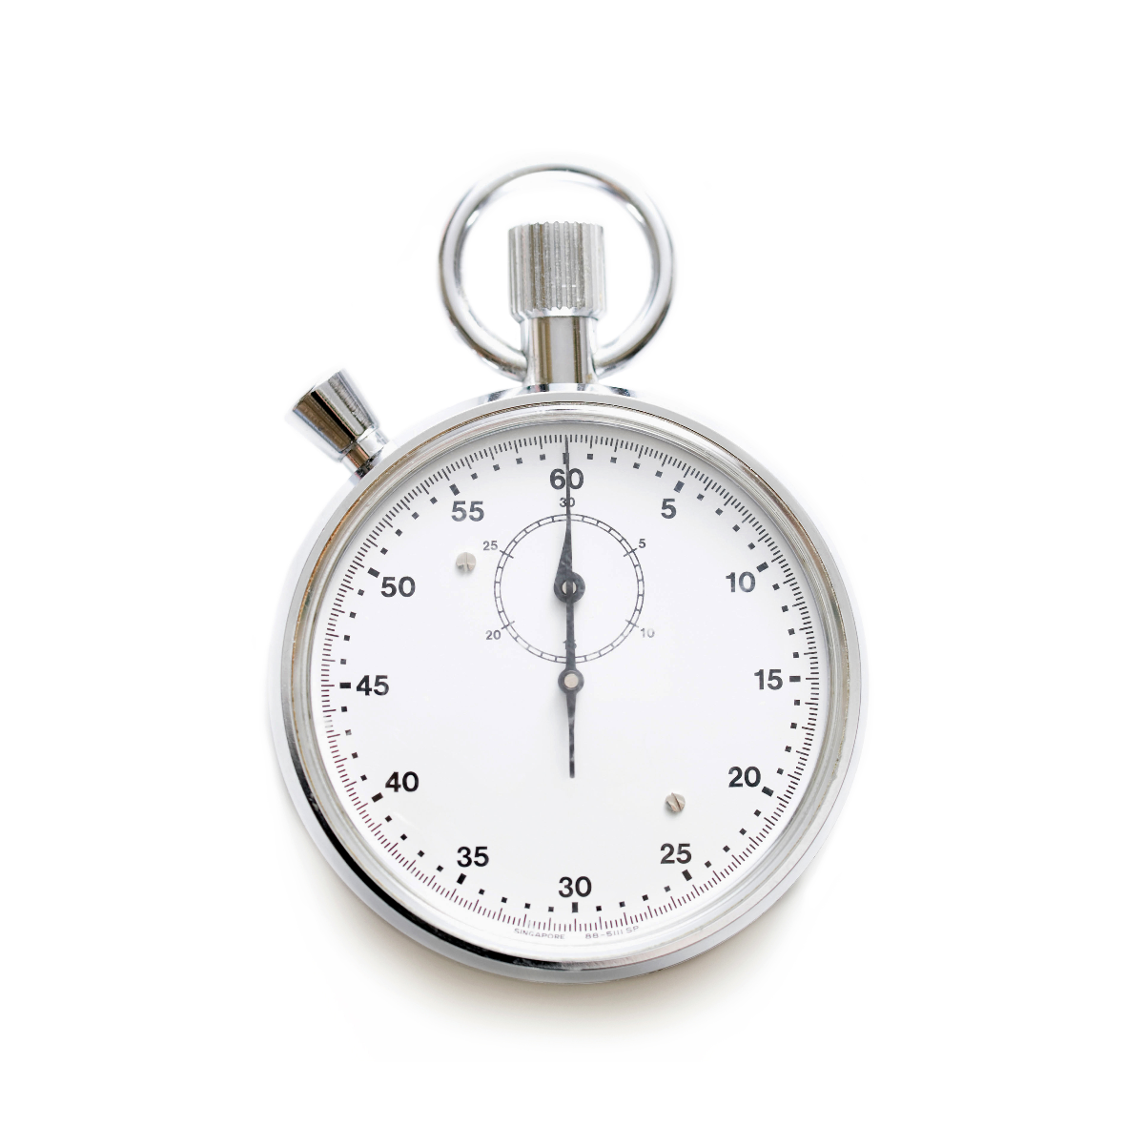
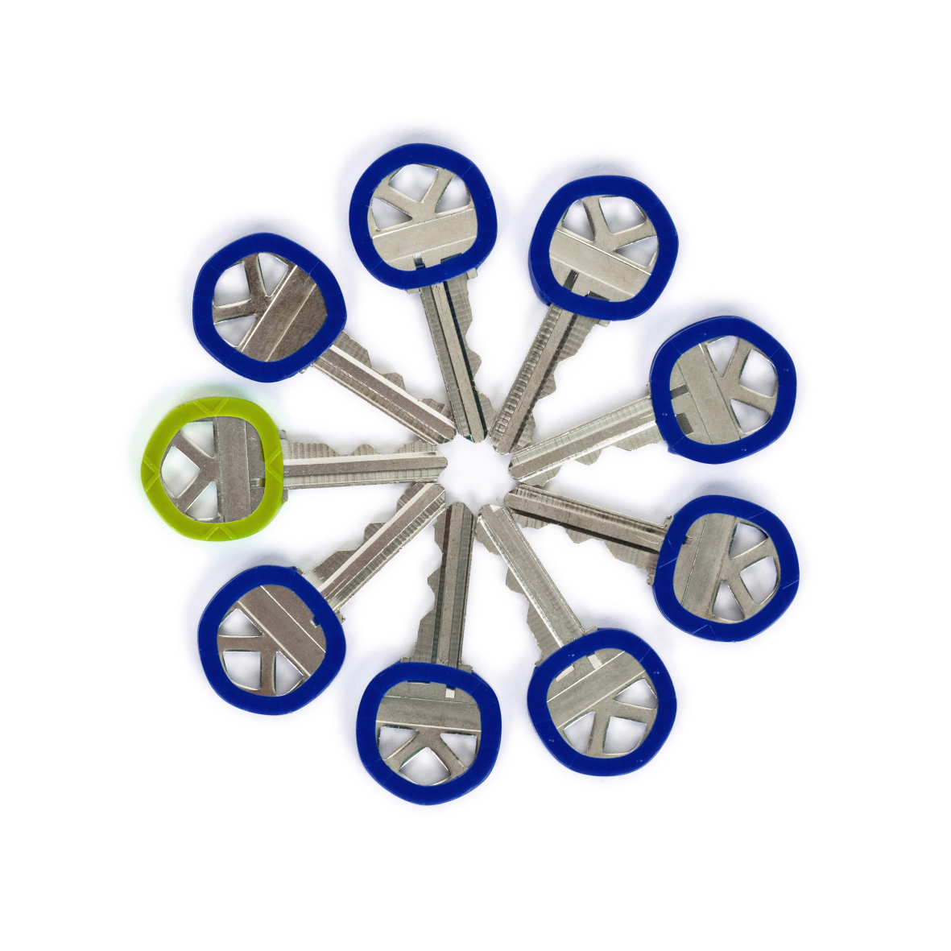

Convergence Project: CP10. Criteria for assessing disclosure of designs on the internet
CP10: Introduction – Key concepts
Exceptions
Confidentiality
Designer/successor in title/third person during grace period
Abuse

Slide 15
Convergence Project: CP10. Criteria for assessing disclosure of designs on the internet
CP10: Introduction – Key concepts
Possible sources
Particularities
Source
Means of presenting the evidence
Representation of the disclosed design in evidence
Design
Date
Establishing the relevant date

Slide 16

Convergence Project: CP10. Criteria for assessing disclosure of designs on the internet
CP10: Introduction – Key concepts. Relevant case-law
Disclosure outside the EU
CP10
C-479/12 of 13/02/2014 (‘Gartenmöbel’), § 33
Court of Justice of the European Union
A design can be disclosed anywhere in the world, including the internet.

Slide 17
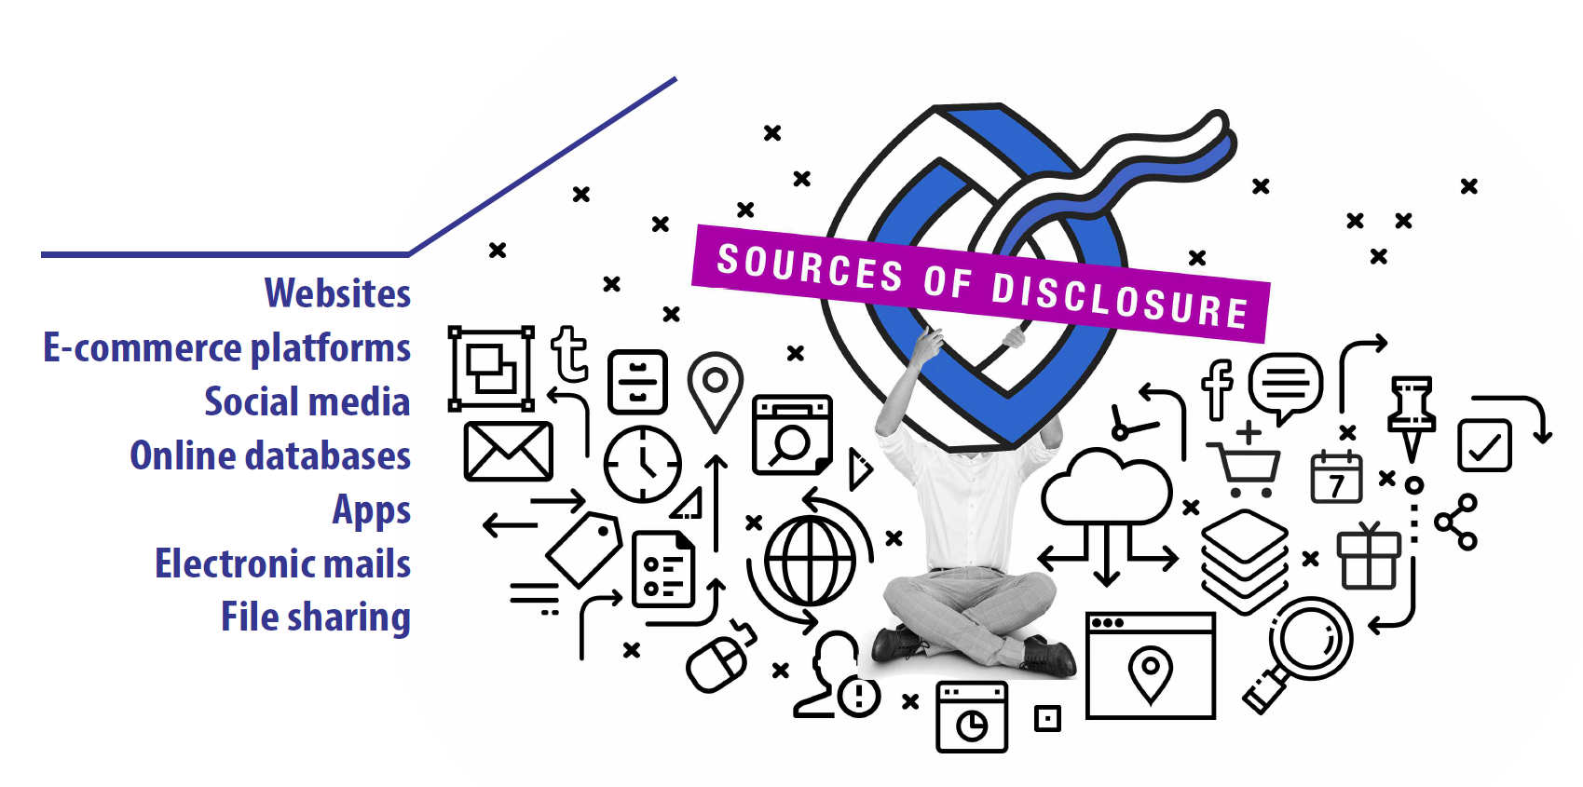
Convergence Project: CP10. Criteria for assessing disclosure of designs on the internet

Slide 18
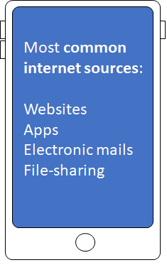
Convergence Project: CP10. Criteria for assessing disclosure of designs on the internet
CP10: Common Practice Principles
Sources of disclosure on the internet

Slide 19
Convergence Project: CP10. Criteria for assessing disclosure of designs on the internet
CP10: Common Practice Principles
Sources of disclosure on the internet
WEBSITES
Types:
E-commerce platforms
Online databases
Social media
Websites

Slide 20
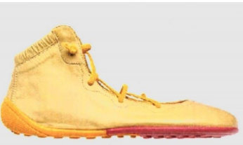
Convergence Project: CP10. Criteria for assessing disclosure of designs on the internet
CP10: Common Practice Principles
Sources of disclosure on the internet. Relevant case-law
E-commerce platforms
CP10
Websites
ZR 187/16 of 11/01/2018 (‘Ballerina shoes’) , § 26 - 27
Federal Supreme Court of Germany I
Offering a product for sale in an e-shop = disclosure

Slide 21
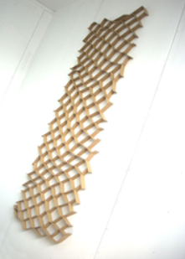

Convergence Project: CP10. Criteria for assessing disclosure of designs on the internet
CP10: Common Practice Principles
Sources of disclosure on the internet. Relevant case-law
Online databases
CP10
Websites
T-251/14 of 15/10/2015 (‘Doors (part of)’),
§ 22
General Court
Publication of a design in an online database administered by public authorities constitutes disclosure
T-513/09 of 16/12/2010 (‘Ornamentación’), § 20
General Court

Slide 22
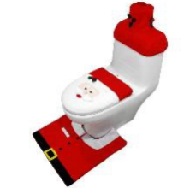
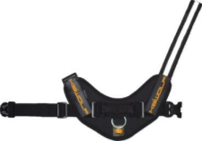

Convergence Project: CP10. Criteria for assessing disclosure of designs on the internet
CP10: Common Practice Principles
Sources of disclosure on the internet. Relevant case-law
Social media
CP10
ICD 10 141 of 17/01/2017 (‘Christmas decorations’), pg. 3
EUIPO
Social media is widely used by designers to share their work and products
When printout/screenshot does not include all relevant information - recommended to submit additional evidence
Websites
ICD 10 364 of 05/12/2016 (‘Animal clothing’), pg. 3
EUIPO
ICD 10 729 of 27/04/2018 (‘Sofas’), pg. 6
EUIPO
37 O 17964/17 of 31/01/2018 (‘Mythos H.’), § 27 - 28
Munich Regional Court I
Provide information regarding the purpose or the nature of the relevant social media services

Slide 23
Convergence Project: CP10. Criteria for assessing disclosure of designs on the internet
CP10: Common Practice Principles
Sources of disclosure on the internet
WEBSITES
Recommendations
01
Present website evidence through a printout or a screenshot
02
Evidence should display clear image of the design, date of disclosure and URL address
Websites
03
Printouts: printing date assumed the date of disclosure, unless earlier relevant date established
04
Submit information regarding the purpose and the main characteristics of the website in question

Slide 24
Convergence Project: CP10. Criteria for assessing disclosure of designs on the internet
CP10: Common Practice Principles
Sources of disclosure on the internet
APPS
App version
Setbacks
Website version
  Difficulty obtaining proof of disclosure through app when information displayed is temporary
  Limited capability of web archiving services to capture historical data from apps
  Limited possibility to create a printout version
Apps
  Same relevant content
  Difference in means to present the evidence

Slide 25
Convergence Project: CP10. Criteria for assessing disclosure of designs on the internet
CP10: Common Practice Principles
Sources of disclosure on the internet
Recommendations
01
  Extract the relevant information from website version (when available)
  If website version not available → screenshot from mobile device
  Screenshot date assumed date of disclosure, unless earlier relevant date established
  Provide information regarding the purpose and the main characteristics of the app
02
Apps
03
04

Slide 26
Convergence Project: CP10. Criteria for assessing disclosure of designs on the internet
CP10: Common Practice Principles
Sources of disclosure on the internet
ELECTRONIC
MAILS
Traditionally, e-mails considered private correspondence. However, if aimed to promote products, it cannot be considered private correspondence
E-mails
What should be taken into consideration is the content of the e-mail, and not its form

Slide 27
Convergence Project: CP10. Criteria for assessing disclosure of designs on the internet
CP10: Common Practice Principles
Sources of disclosure on the internet
Recommendations
01
  E-mail evidence should include:
    representation of design
    clear indication of relevant date
  Indicators of circle specialised in the sector concerned: recipients of the e-mail and its purpose
  Veracity of the confidentiality claim: keep in mind the contents, recipients and purpose of an e-mail
E-mails
02
03

Slide 28
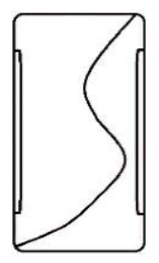
Convergence Project: CP10. Criteria for assessing disclosure of designs on the internet
CP10: Common Practice Principles
Sources of disclosure on the internet. Relevant case law
CP10
T-166/15 of 27/02/2016 (‘Cases for mobile phones’), § 93
General Court
When assesing disclosure through e-mails, take into account the content (not form)
E-mail promoting products not private correspondence
E-mails

Slide 29
Convergence Project: CP10. Criteria for assessing disclosure of designs on the internet
CP10: Common Practice Principles
Sources of disclosure on the internet
FILE
SHARING
File incorporating design uploaded to a file sharing system = disclosure (in principle)
File Sharing
2 key aspects:
  link between the contents of the file containing a design and the file’s reference in the file sharing system
  relevant date

Slide 30
Convergence Project: CP10. Criteria for assessing disclosure of designs on the internet
CP10: Common Practice Principles
Sources of disclosure on the internet
Recommendations
01
  If evidence includes disclosure via file sharing, submit additional evidence
  Relevant date could be date of the upload of a file or when file was actually downloaded
  Use computer-generated timestamping or public notary services to prove link between contents of a file and its indexing reference
02
File Sharing
03

Slide 31

Convergence Project: CP10. Criteria for assessing disclosure of designs on the internet

Slide 32
Convergence Project: CP10. Criteria for assessing disclosure of designs on the internet
CP10: Common Practice Principles
Establishing relevant date of disclosure
Necessary criterion for assessing disclosure
Establishment of the date of disclosure:
i.e. the date when the design was made available to the public
This section provides
Non-exhaustive list of tools to help determine relevant date when design made available on the internet

Slide 33

Convergence Project: CP10. Criteria for assessing disclosure of designs on the internet
Establishing the relevant date of disclosure
Establishing relevant date of disclosure
Tools:
1
Search engines and web archiving services
2
Computer-generated timestamps
3
Software forensic tools

Slide 34
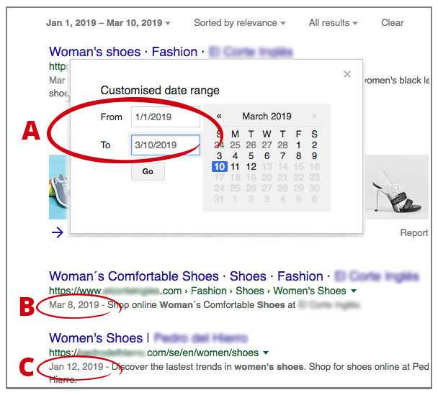
Convergence Project: CP10. Criteria for assessing disclosure of designs on the internet
CP10: Common Practice Principles
Establishing relevant date of disclosure
Search engines allow users to search for the information within a specific time frame
Search engines and website archiving services

Slide 35
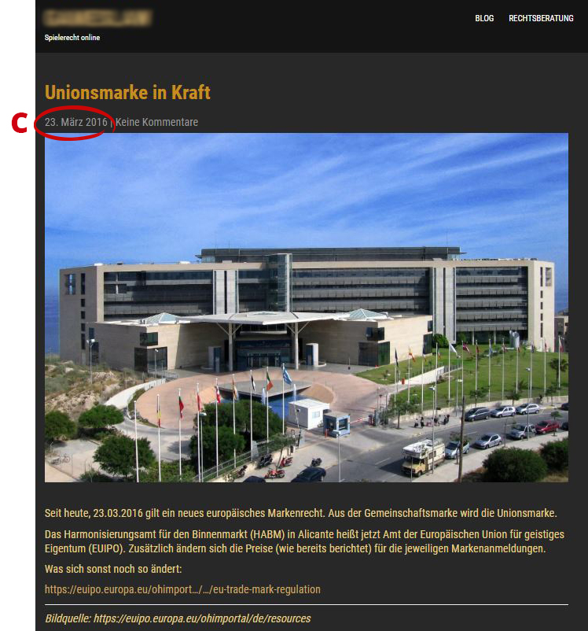

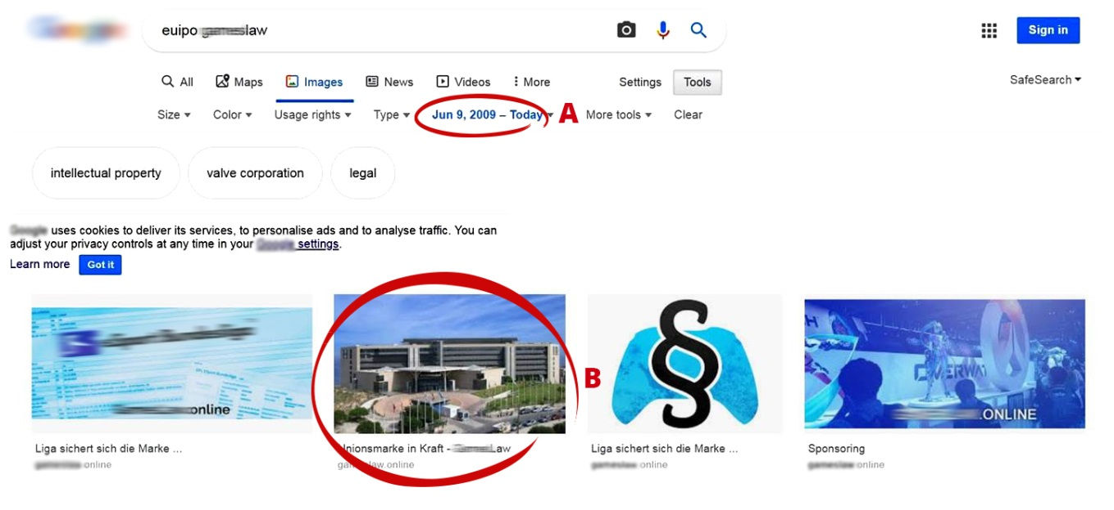

Convergence Project: CP10. Criteria for assessing disclosure of designs on the internet
CP10: Common Practice Principles
Establishing relevant date of disclosure
Setbacks
Established time frame search (‘A’) might give a result of when the site was cached (‘B’) and not the date when the content was published (‘C’)
Search engines and website archiving services
Use with caution!

Slide 36
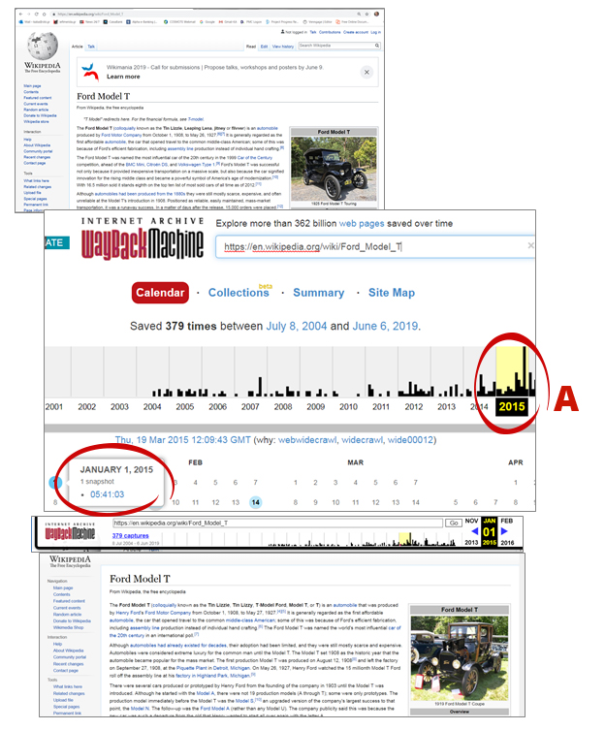
Convergence Project: CP10. Criteria for assessing disclosure of designs on the internet
CP10: Common Practice Principles
Establishing relevant date of disclosure
Website archiving services (e.g.“WayBack Machine”) can help prove date of disclosure.
  Access to archived websites or parts thereof as they appeared at a certain point in time (‘captures’) (‘A’)
  Possibility to view and navigate them
Search engines and website archiving services

Slide 37
Convergence Project: CP10. Criteria for assessing disclosure of designs on the internet
CP10: Common Practice Principles
Establishing relevant date of disclosure
Setbacks
  limited access to website content
  content removal
  sporadic updates
Search engines and website archiving services
Recommendations
01
  Use website archiving services instead of search engine services
  Separate parts of the archived website might relate to different dates
02

Slide 38
Convergence Project: CP10. Criteria for assessing disclosure of designs on the internet
CP10: Common Practice Principles
Establishing relevant date of disclosure. Relevant case-law
CP10
No. O-544-17 of 27/10/2017 (‘plastic bottle, aluminum bottle, chemical bottle, general use bottle, fuel tank applications bottle’), § 38
UKIPO
R 25/2014-3 of 02/07/2015 (‘Soft drink bottle’), § 29
R 1537/2016-3 of 28/09/2017 (‘Wheel rims’), § 22
R 2112/2015-3 of 08/03/2017 (‘Flushing systems for water closets’) , § 42
R 1849/2015-3 of 20/12/2016 (‘Doors’), § 24
R 1341/2013-3 of 05/03/2015 (‘Packaging’), § 18
EUIPO
Web archiving services is a valuable tool for proving the date of disclosure.
However, in order to prove disclosure using this tool, the relevant date should be corroborated by further information.
Search engines and website archiving services

Slide 39
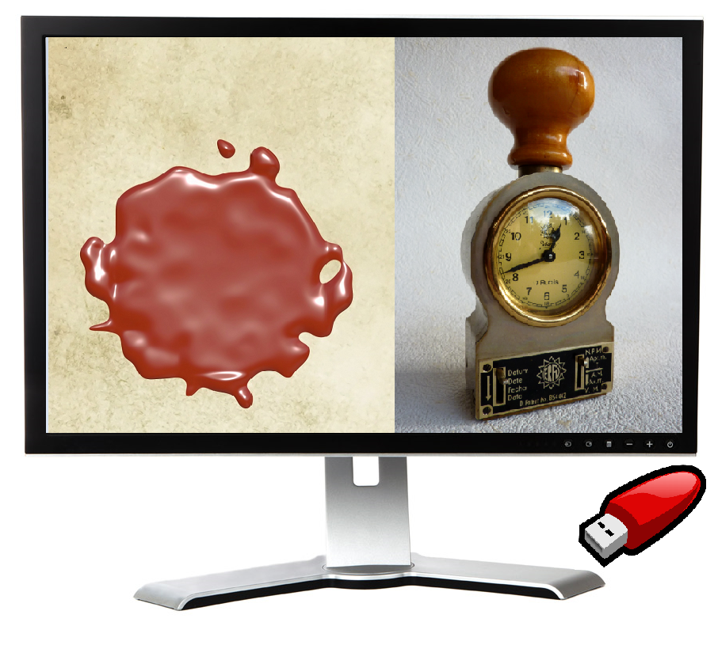
Convergence Project: CP10. Criteria for assessing disclosure of designs on the internet
CP10: Common Practice Principles
Establishing relevant date of disclosure
Electronic timestamps assign an exact time to a file, message, transaction, image etc.
EU trust mark
for qualified
trust services
Computer-generated timestamp information
Timestamping can secure the content in screenshot/printout from later being amended/removed

Slide 40
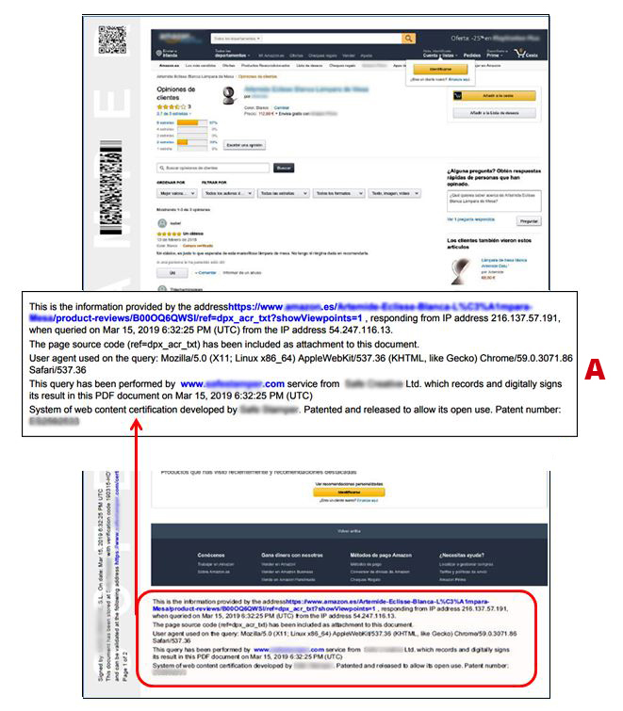
Convergence Project: CP10. Criteria for assessing disclosure of designs on the internet
CP10: Common Practice Principles
Establishing relevant date of disclosure
Timestamping service issues certificate verifying the timestamped content
Computer-generated timestamp information
Both static websites and browsing sessions can be timestamped

Slide 41
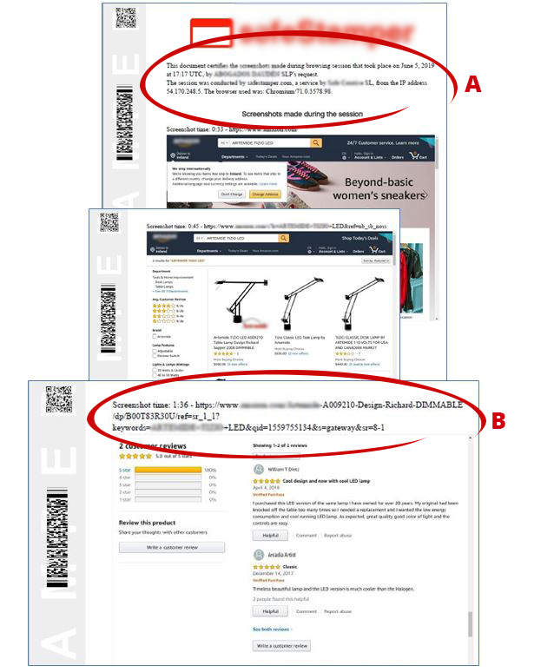
Convergence Project: CP10. Criteria for assessing disclosure of designs on the internet
CP10: Common Practice Principles
Establishing relevant date of disclosure
Timestamping browsing sessions: timestamp several screenshots or record a video of a web browsing session
Computer-generated timestamp information
Timestamped certificate including video information/screenshots taken during the browsing session

Slide 42
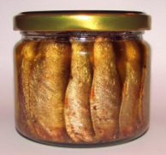
Convergence Project: CP10. Criteria for assessing disclosure of designs on the internet
CP10: Common Practice Principles
Establishing relevant date of disclosure. Relevant case-law
CP10
ICD 10 388 of 23/11/2017 (‘Jars’), pg. 7
EUIPO
Timestamping secures content in screenshots/printouts from being later amended/removed from its original source
Use timestamping as a precautionary measure in order to secure evidence
Computer-generated timestamp information

Slide 43
Convergence Project: CP10. Criteria for assessing disclosure of designs on the internet
CP10: Common Practice Principles
Establishing relevant date of disclosure
Recommendations
01
Use timestamping to secure the evidence of disclosure (precautionary measure)
If several steps required to obtain the relevant evidence, timestamp the entire browsing session
Computer-generated timestamp information
02

Slide 44
Convergence Project: CP10. Criteria for assessing disclosure of designs on the internet
CP10: Common Practice Principles
Establishing relevant date of disclosure
Can extract information concerning the relevant date which might be embedded in images, videos or programming (i.e. metadata)
Forensic software tools
Recommendations
01
Provide information explaining the tool, how the information was obtained, what kind of information was extracted and from which content it was taken

Slide 45
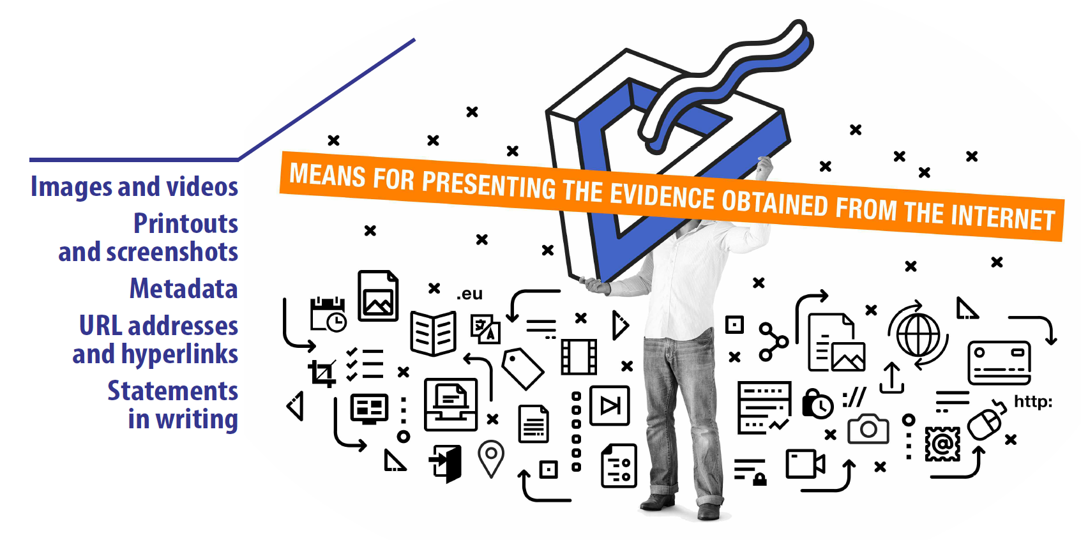
Convergence Project: CP10. Criteria for assessing disclosure of designs on the internet

Slide 46
Convergence Project: CP10. Criteria for assessing disclosure of designs on the internet
CP10: Common Practice Principles
Means for establishing the date of disclosure
Any means able to prove disclosure (or rebut the availability) of a design can be submitted
Disclosure can be established by submitting various types of evidence
Evidence proving disclosure extracted from the internet can be submitted with other pieces of evidence
Integrity of the documents submitted is assumed

Slide 47
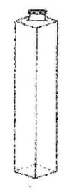
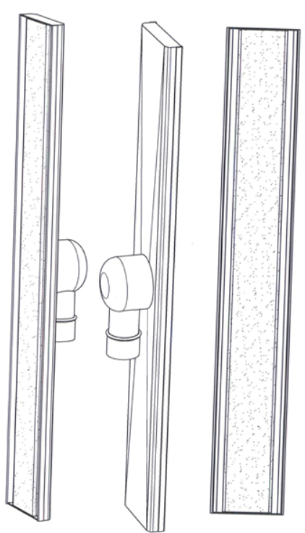
Convergence Project: CP10. Criteria for assessing disclosure of designs on the internet
CP10: Common Practice Principles
Means for establishing the date of disclosure. Relevant case-law
CP10
T-450/08 of 09/03/2012
(‘Phials’), §24 – 25, 30 – 45
General Court
Even if some pieces of evidence are not conclusive in themselves, they may contribute to proving an event of disclosure
Disclosure must be demonstrated through solid and objective evidence (and not probabilities or suppositions)
C-361/15 P and C-405/15 P of 21/09/2017
(‘Shower drainage channel’), § 69
C-345/13 of 19/06/2014
(‘Karen Millen Fashions’), § 35
Court of Justice of the EU
Several features disclosed in various pieces of evidence relating to different designs cannot be combined for the purposes of disclosure of a single design

Slide 48


Convergence Project: CP10. Criteria for assessing disclosure of designs on the internet
CP10: Common Practice Principles
Means for establishing the date of disclosure. Relevant case-law
CP10
No. O-636-17 of 12/12/2017 (‘Service dog label’), § 16
UKIPO
Integrity of the documents submitted is assumed
Evidence should only be rejected in case of reasonable doubt
T-166/15 of 27/02/2018 (‘Cases for mobile phones’), § 64, 90
General Court
R 62/2015-3 of 25/05/2016 (‘Bracelets (jewelry), bracelets, bangles’), § 20, 23
EUIPO

Slide 49
Convergence Project: CP10. Criteria for assessing disclosure of designs on the internet
CP10: Common Practice Principles
Means for establishing the date of disclosure
Recommendations
01
Clearly indicate the source of disclosure
If necessary, provide additional information (on the source)
Ensure the quality of the evidence is sufficient to define the features of the design and identify the relevant date
02
03

Slide 50
Convergence Project: CP10. Criteria for assessing disclosure of designs on the internet
CP10: Common Practice Principles
Means for establishing the date of disclosure
Printouts and screenshots should
contain:
  the source (e.g. URL address)
  the relevant date
  the disclosed design
Printouts and Screenshots
not be manually modified

Slide 51
Convergence Project: CP10. Criteria for assessing disclosure of designs on the internet
CP10: Common Practice Principles
Means for establishing the date of disclosure
Recommendations
When a printout or screenshot does not include all of the relevant information, submit additional evidence providing the missing elements
When a printout or a screenshot is inserted in the text of the submissions and contains additions for illustrative purposes, such as highlighting or indicating the relevant elements, submit an unaltered version of the printout or screenshot as a separate document
Printouts and Screenshots

Slide 52
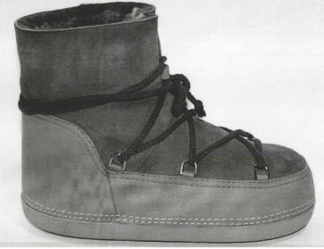
Convergence Project: CP10. Criteria for assessing disclosure of designs on the internet
CP10: Common Practice Principles
Means for establishing the date of disclosure. Relevant case-law
CP10
R 1629/2017-3 of 30/11/2018 ('Boots'), § 23 - 24
EUIPO
If information extracted from printouts is inserted in the submission, an unaltered, separate version should also be submitted
Printouts and screenshots should contain the:
  source (URL address)
  relevant date
  disclosed design
Printouts and Screenshots

Slide 53
Convergence Project: CP10. Criteria for assessing disclosure of designs on the internet
CP10: Common Practice Principles
Means for establishing the date of disclosure
Recommendations
If the printout/screenshot does not include all of the above information,submit additional evidence providing the missing information
If printout/screenshot submitted in submission, submit an unaltered and separate version of the pritout/screenshot
Printouts and Screenshots

Slide 54
Convergence Project: CP10. Criteria for assessing disclosure of designs on the internet
CP10: Common Practice Principles
Means for establishing the date of disclosure
A) Source
Specific source of disclosure (e.g. a URL address) might not always be (fully) apparent from printouts/screenshots
Printouts and Screenshots
Recommendations
If not completely displayed in a printout/screenshot, provide additional evidence in this respect

Slide 55
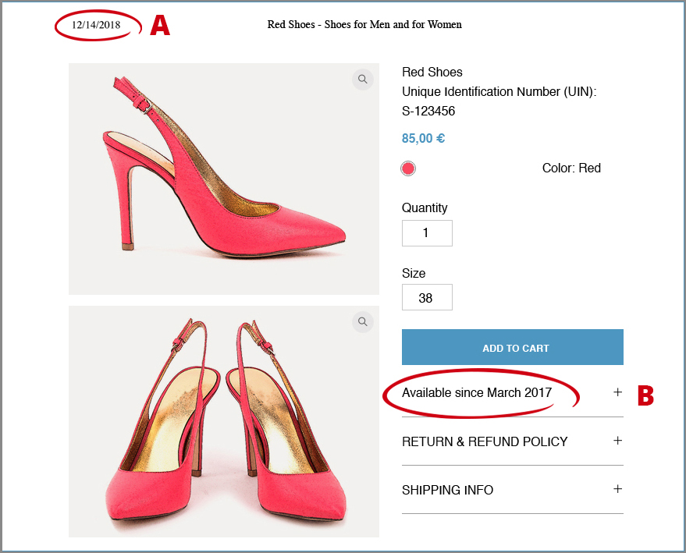
Convergence Project: CP10. Criteria for assessing disclosure of designs on the internet
CP10: Common Practice Principles
Means for establishing the date of disclosure
B) Relevant date
Distinguish between printing date (printout) and date of disclosure
Printing date (‘A’) assumed date of disclosure, unless an earlier relevant date can be established from:
  URL address
  contents of the document itself or
  any other evidence (‘B’)
Printouts and Screenshots

Slide 56
Convergence Project: CP10. Criteria for assessing disclosure of designs on the internet
CP10: Common Practice Principles
Means for establishing the date of disclosure
B) Relevant date
Recommendations
When several dates are indicated in a printout/screenshot, clearly indicate which is the relevant date
Printouts and Screenshots

Slide 57
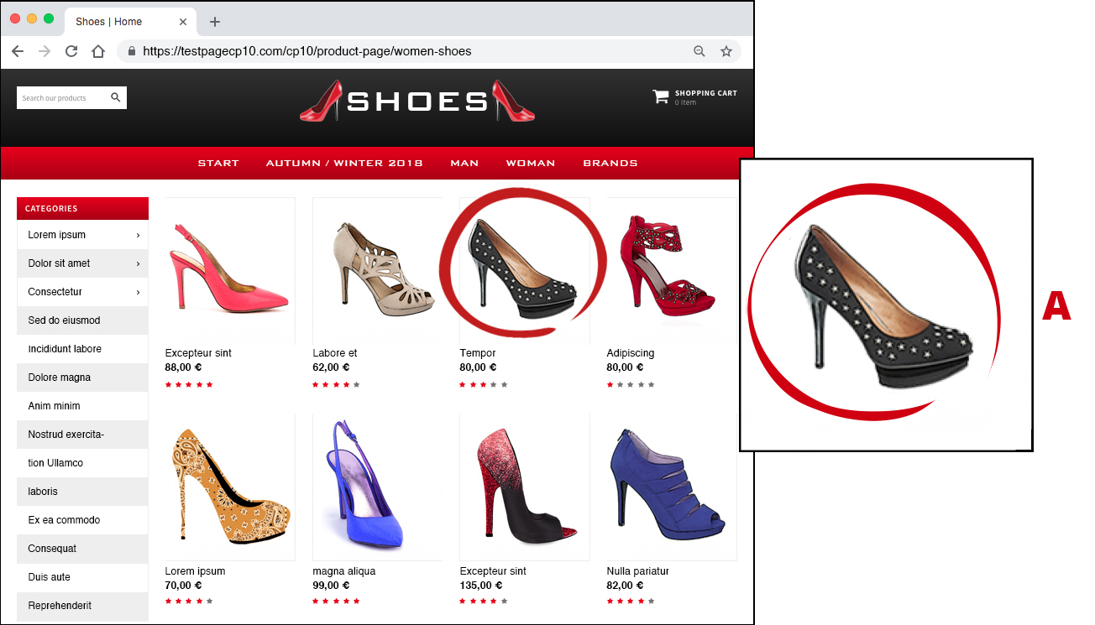
Convergence Project: CP10. Criteria for assessing disclosure of designs on the internet
CP10: Common Practice Principles
Means for establishing the date of disclosure
C) The disclosed design
Printouts/screenshots may show several designs (e,g. screenshot of retailer website)
Printouts and Screenshots
When several products are displayed in a single printout/screenshot, clearly indicate which is the relevant design (‘A’)

Slide 58
Convergence Project: CP10. Criteria for assessing disclosure of designs on the internet
CP10: Common Practice Principles
Means for establishing the date of disclosure
CP10
C-361/15 P and C-405/15 P of 21/09/2017 (‘Shower drainage channel’), § 65
General Court
Images of a disclosed design should be precise and of sufficient quality to allow the definition of its features
Printouts and Screenshots

Slide 59
Convergence Project: CP10. Criteria for assessing disclosure of designs on the internet
CP10: Common Practice Principles
Means for establishing the date of disclosure
C) The disclosed design
Recommendations
  Submit as many screenshots or printouts (also to enlarge the smaller views) as necessary to completely represent the design
  If several designs appear in a screenshot or a printout, provide enlarged views of the design and clearly indicate which is the relevant design
  When printouts/screenshots including additions for illustrative purposes (e.g. highlighting, arrows or boundaries), submit an unaltered version of the document
01
Printouts and Screenshots
02
03

Slide 60
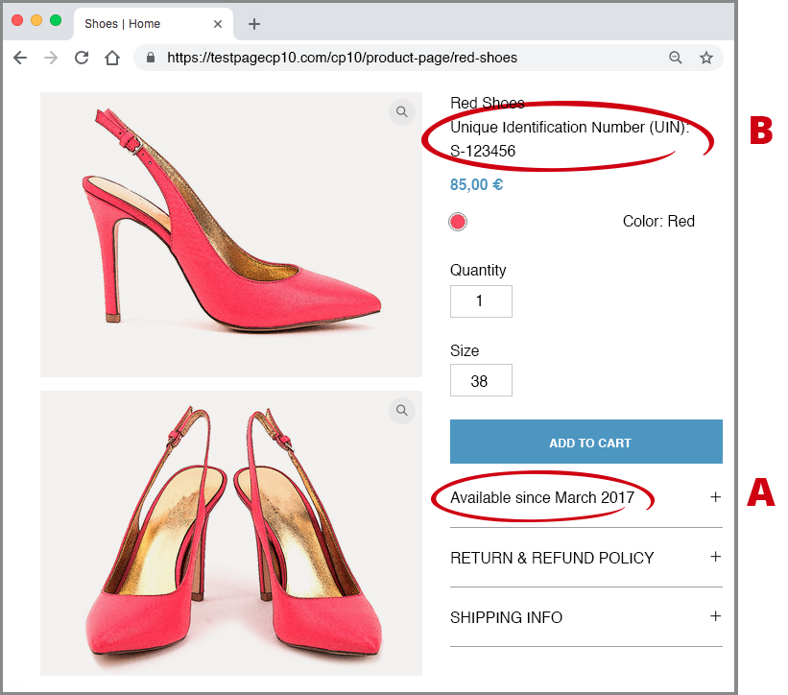
Convergence Project: CP10. Criteria for assessing disclosure of designs on the internet
CP10: Common Practice Principles
Means for establishing the date of disclosure
Printouts and screenshots from
e-commerce platforms
E-commerce platforms can indicate the date when the product was first available for sale (‘A’)
The specific product reference (e.g. name or a code) can link information on the product contained in other evidence (’B’)
Printouts and Screenshots

Slide 61
Convergence Project: CP10. Criteria for assessing disclosure of designs on the internet
CP10: Common Practice Principles
Means for establishing the date of disclosure
Printouts and screenshots from e-commerce platforms
Recommendations
Include reviews from users, as it might help establish date of disclosure
A unique code identifying the relevant product can link the information displayed on the e-commerce platform (e.g. design) and that contained in the other evidence (e.g. date of sale)
01
Printouts and Screenshots
02

Slide 62
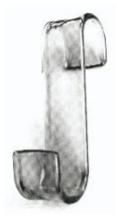
Convergence Project: CP10. Criteria for assessing disclosure of designs on the internet
CP10: Common Practice Principles
Means for establishing the date of disclosure. Relevant case-law
CP10
T-166/15 of 27/02/2018 (‘Cases for mobile phones’),
§ 59 - 63
General Court
R 3146/2014-3 of 02/02/2016 (‘Bathroom accessories’), § 33
EUIPO
Specific product reference and the ‘product available since…’ reference can link product to information contained in other evidence
Printouts and Screenshots

Slide 63
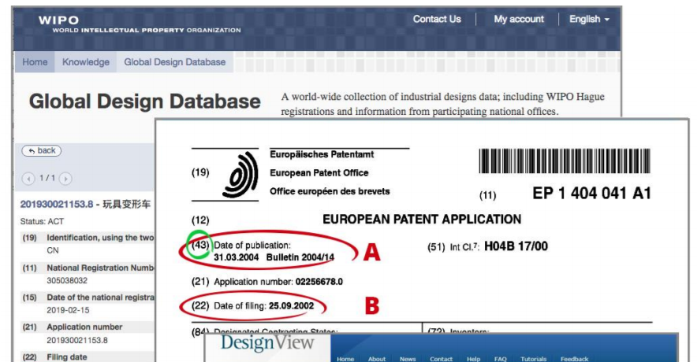
Convergence Project: CP10. Criteria for assessing disclosure of designs on the internet
CP10: Common Practice Principles
Means for establishing the date of disclosure
Printouts and screenshots from online databases
Publication date from online databases = relevant date (‘A’)
Designs published in online databases administered by public authorities = disclosed as from the indicated publication date
Printouts and Screenshots

Slide 64
Convergence Project: CP10. Criteria for assessing disclosure of designs on the internet
CP10: Common Practice Principles
Means for establishing the date of disclosure
Recommendations
01
Indicate the publication date
Printouts and Screenshots
02
  Show the INID code 43/45 (when possible)

Slide 65
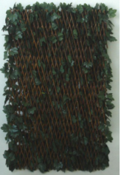
Convergence Project: CP10. Criteria for assessing disclosure of designs on the internet
CP10: Common Practice Principles
Means for establishing the date of disclosure
Online databases
CP10
ICD 9822 of 13/07/2015 (‘Hedges, fences’), § 12
EUIPO
Show the publication date and/or the INID code 43 or 45
Printouts and Screenshots

Slide 66

Convergence Project: CP10. Criteria for assessing disclosure of designs on the internet
CP10: Common Practice Principles
Means for establishing the date of disclosure
Relevant date:
  When image/video viewed, or
  When made available for viewing/downloading
Images and Videos

Slide 67
Convergence Project: CP10. Criteria for assessing disclosure of designs on the internet
CP10: Common Practice Principles
Means for establishing the date of disclosure
Recommendations
01
  If the video itself is submitted:
    provide information on when and where the video was made available
    indicate exact moment the design is visible in the video
  Comments by users can provide dates
  Provide information on the source of where the images/video is uploaded
Images and Videos
02
03

Slide 68
Convergence Project: CP10. Criteria for assessing disclosure of designs on the internet
CP10: Common Practice Principles
Means for establishing the date of disclosure
Means to obtain metadata:
  “information” option on device
  Specialised software (“metadata viewers”)
Metadata
Recommendations
Provide information on the extraction of the embedded information

Slide 69
Convergence Project: CP10. Criteria for assessing disclosure of designs on the internet
CP10: Common Practice Principles
Means for establishing the date of disclosure
URL addresses/hyperlinks per se insufficient to prove disclosure:
  site of the link may be altered/removed
  Difficulty identifying the information
URL Addresses and Hyperlinks
Recommendations
Submit along with URL/hyperlink printout/screenshot of the relevant information

Slide 70
Convergence Project: CP10. Criteria for assessing disclosure of designs on the internet
CP10: Common Practice Principles
Means for establishing the date of disclosure
Recommendations
Statements in writing should be supported by additional evidence
Statements in writing

Slide 71
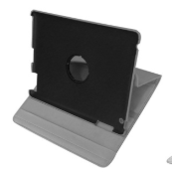
Convergence Project: CP10. Criteria for assessing disclosure of designs on the internet
CP10: Common Practice Principles
Means for establishing the date of disclosure. Relevant case-law
CP10
T-813/14 of 18/11/2015 (‘Cases for portable computers’), § 29
General Court
T‑498/13 of 11/12/2014 (‘NAMMU’),
§ 38
General Court
T-450/08 of 09/07/2012 (‘Phials’), § 39-40
General Court
Statements in writing would not be sufficient on its own to prove an event of disclosure
Statements in Writing

Slide 72
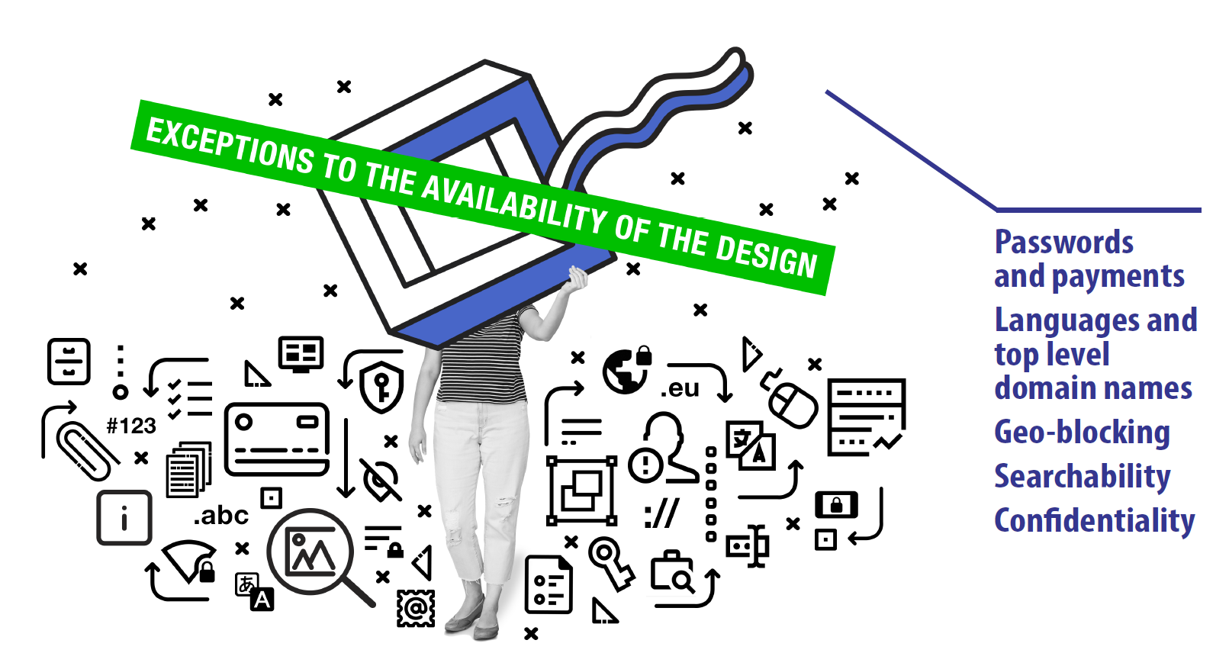
Convergence Project: CP10. Criteria for assessing disclosure of designs on the internet

Slide 73
Convergence Project: CP10. Criteria for assessing disclosure of designs on the internet
CP10: Common Practice Principles
Exceptions to the availability of designs on the internet
Exceptions
  Not reasonably known in the normal course of business
  Under explicit/implicit confidentiality conditions
  Made available by designer/successor in title/third person during 12-month grace period
  Consequence of an abuse in relation

Slide 74
Convergence Project: CP10. Criteria for assessing disclosure of designs on the internet
CP10: Common Practice Principles
Exceptions to the availability of designs on the internet
CP10
R 853/2014-3 of 06/06/2016 (‘Footwear’), § 83 – 84
EUIPO
Taking into account the global nature of the internet, in general, online content is avaliable worldwide.
To refute the presumption of disclosure, the exception has to be proven by submitting respective evidence.
Searchability
T-651/16 of 14/03/2018 (‘Footwear’), § 54, 56, 61
General Court
“When analysing whether events of disclosure of a design could not have reasonably become known to the circles specialised in the sector concerned, examine whether it was not actually possible for those circles to be aware of the events constituting disclosure of a design.”

Slide 75





Convergence Project: CP10. Criteria for assessing disclosure of designs on the internet
Exceptions to the availability of the design
Exceptions to the availability of designs on the internet
Passwords
&
payments
Languages
&
top-level
domain names
Searchability
Geo-blocking
Confidentiality

Slide 76

Convergence Project: CP10. Criteria for assessing disclosure of designs on the internet
CP10: Common Practice Principles
Exceptions to the availability of designs on the internet
In general, neither restricting access to a limited circle of people by password protection, nor requiring payment for access would prevent a design that has been made available on a webpage, app or file sharing platform from forming the prior art.
  Exception: internal databases used by employees of a company
Passwords and Payments

Slide 77
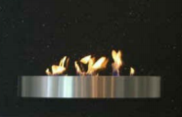
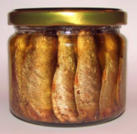
Convergence Project: CP10. Criteria for assessing disclosure of designs on the internet
CP10: Common Practice Principles
Exceptions to the availability of designs on the internet. Relevant case-law
CP10
ICD No 9862 of 03/03/2016 (‘Fireplaces (indoor -)’), pg. 4
EUIPO
ICD 10 388 of 23/11/2017 (‘Jars’), pg. 7
EUIPO
Password protection/payment for access does not prevent a design from forming part of the prior art
Passwords and Payments

Slide 78

Convergence Project: CP10. Criteria for assessing disclosure of designs on the internet
CP10: Common Practice Principles
Exceptions to the availability of designs on the internet
Languages:
  Do not (in principle) affect perception of a design – but can impair the possibility to find them on the internet
  Image search technology allows designs published in different languages to be found
Language and Top-level Domains
Top-level domain:
  In principle, not an obstacle to find designs on the Internet
  But can serve as an indicator of the likelihood of the specialized circle accessing the site

Slide 79
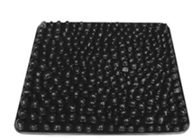
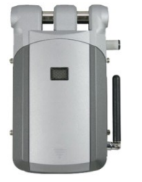
Convergence Project: CP10. Criteria for assessing disclosure of designs on the internet
CP10: Common Practice Principles
Exceptions to the availability of designs on the internet. Relevant case-law
CP10
T-227/16 of 21/06/2018 (‘Floor covering’), § 28
General Court
Establish whether the specialized circle is expected to search for information in the respective language
Depending on the sector concerned, it can be usual or not for the specialised circles to consult information in non-EU languages
Language and Top-level Domains
R 1750/2016-3 of 04/01/2018 (‘Locks’), § 13 - 15
EUIPO

Slide 80

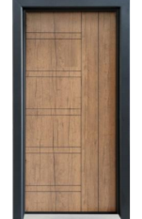
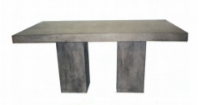
Convergence Project: CP10. Criteria for assessing disclosure of designs on the internet
CP10: Common Practice Principles
Exceptions to the availability of designs on the internet. Relevant case-law
CP10
ICD 10 422 of 21/02/2017 (‘Air Fresheners’), pg. 4 - 5
EUIPO
Top-level domains in principle do not affect the possibility to find designs on the internet
They can serve as an indication as to whether the specialised circles were likely to access a website
Language and Top-level Domains
ICD No 10 113 of 18/05/2017 (‘Doors’), pg. 3
EUIPO
R 2301/2012-3 of 12/02/2015 (‘Tables’), § 31
EUIPO

Slide 81

Convergence Project: CP10. Criteria for assessing disclosure of designs on the internet
CP10: Common Practice Principles
Exceptions to the availability of designs on the internet
Searchability
Assess the possibility for the specialized circle to find the prior art on the internet
  Consider whether the site was technically accessible
  Customs/behaviours in the normal course of business
Searchability

Slide 82



Convergence Project: CP10. Criteria for assessing disclosure of designs on the internet
CP10: Common Practice Principles
Exceptions to the availability of designs on the internet
  Regulation (EU) 2018/302 (Geo-blocking regulation) aims to give all EU consumers equal rights to access a trader's goods or services, under the same terms, irrespective of their location
    Restricted access to premium multimedia contents
    Block malicious traffic
    Enforcement of price discrimination
Geo-blocking

Slide 83

Convergence Project: CP10. Criteria for assessing disclosure of designs on the internet
CP10: Common Practice Principles
Exceptions to the availability of designs on the internet
Designs disclosed under explicit/implicit confidentiality conditions will not constitute disclosure
Circumstances that might affect the effectiveness of the confidentiality claim in an e-mail:
  contents
  purpose
  recipients
Confidentiality

Slide 84
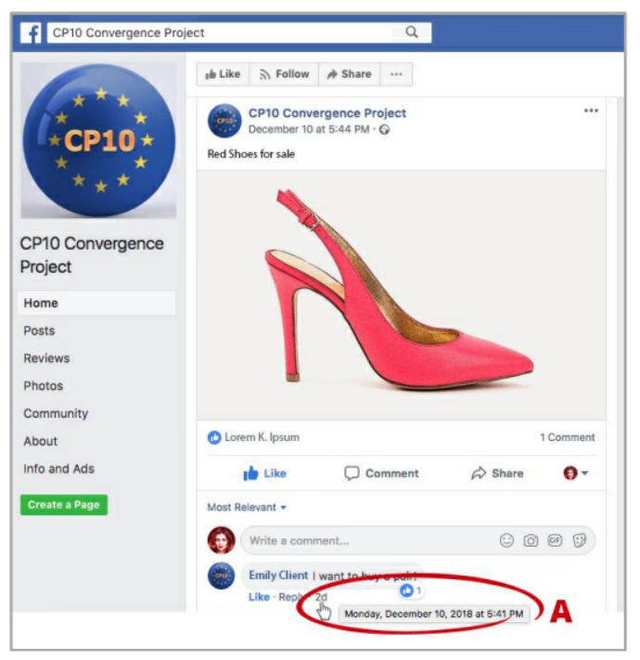
Convergence Project: CP10. Criteria for assessing disclosure of designs on the internet
CP10: Common Practice Principles
Exceptions to the availability of designs on the internet
Recommendations
01
  Website traffic can help determine whether specialised circles could have accessed the website’s contents
  When assessing availability of the design on the internet, take into account:
    tagging systems, hashtags and links between search terms and images of the design
    ‘popularity’ indicators on social media platforms (number of people reached, views, clicks for the post, reactions, comments, shares, followers and likes) (‘A’)
02

Slide 85


