Slide 1

What has changed in the examination of trade marks?
WEBINAR
07/12/2023
DIMITRIOS GIAGTZIDIS
dgia@obi.gr
Τ. 211 109 7917
email: info@obi.gr
G. Stavroulaki 5
151 25 Paradeisos Amarousiou
www.obi.gr

Slide 2
L.4679/2020( GG Issue 71/ Α/20-03-2020)=
Transposes Directive (EU) 2015/2436 to approximate the laws of the Member States relating to trade marks
THE MOST IMPORTANT CHANGES:

Slide 3
1. ELIMINATION of the requirement of a graphic representation for a trade mark to exist:
“Trade mark is any sign which can be represented graphically....”
Art. 2, par. 1/L. 4679/2020 “The national trade mark may consist of any signs, in particular words (including personal names)/ or designs/ letters, numerals/ colours/ the shape of goods or of the packaging of goods/ sounds, provided that such signs are capable of:
a) distinguishing the goods / services of one undertaking from those of other undertakings;
b) being represented on the register in a manner which enables the competent authorities and the public to determine the clear and precise subject matter of the protection afforded to its proprietor.

Slide 4
2. Trade marks can now be filed in an electronic form based on electronic files (JPG, MP3, MP4 etc.), as set forth in art. 2 par. 2 of the new law.
The definition is provided for each trade mark category, its manner of representation and the e-filing platform contains the technical specifications for e-filing (transposition of art. 3 of Regulation (EU) 2018/626).
Enabling provision: Min. of Development determines the type & technical detail of the files (art. 2 par. 6, L4679/ 20).

Slide 5
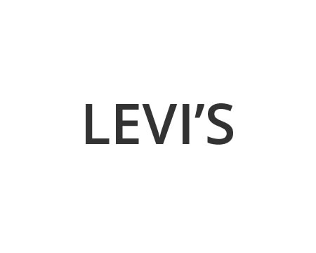







WORD MARK
FIGURATIVE MARK (JPEG)

Slide 6
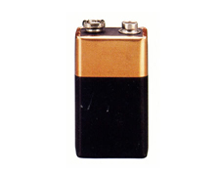
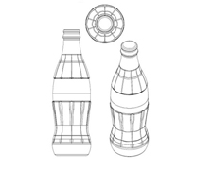

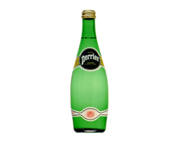
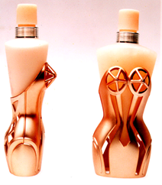
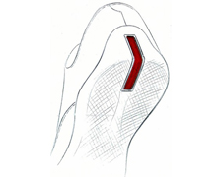
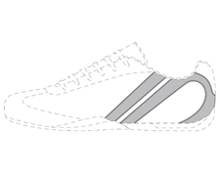
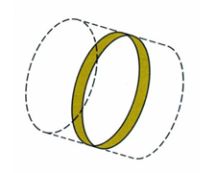
3D (JPEG, OBJ, STL, X3D)
POSITION MARK (JPEG)

Slide 7





PATTERN MARK (JPEG)
COLOUR MARK (JPEG)

Slide 8



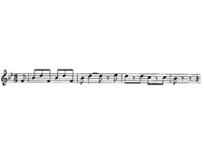

COLOUR COMBINATION MARK (JPEG)
SOUND MARK (JPEG, MP3-max 2Mb) NEW
Only an audio file reproducing the sound or an accurate representation of the sound in musical notation shall be accepted.

Slide 9
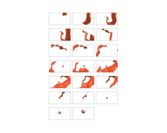
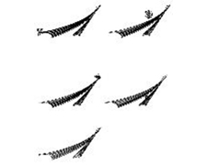
MOTION MARK [MP4 (video), JPEG (series of sequential still images)] NEW

Slide 10
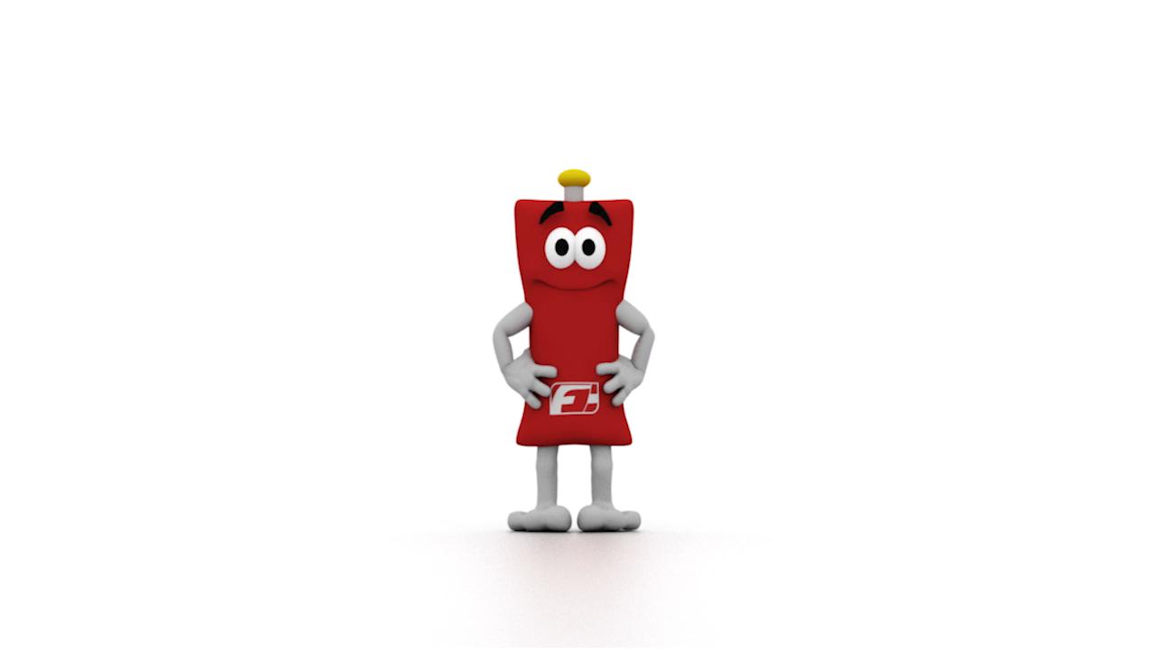
AUDIOVISUAL MARK (MP4 (max 20 Mb)) NEW

Slide 11
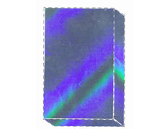


HOLOGRAM MARK [JPEG, MP4 (maximum 20 Mb)] NEW

Slide 12
The Front Office checks:
the representation of the new trade mark in the relevant files in conjunction with its description in the application (the description is not contrary to the representation of the trade mark nor the extend its scope)
provided that the technical specifications for registration are met
3D: OBJ, STL and X3D images, max 20 MB
Position: JPEG file or a single A4 sheet of paper
Pattern: JPEG file or a single A4 sheet of paper
NEW
Sound: ΜΡ3 max 2 ΜΒ, AUDIO/MPEG, WAVE
Motion: MP4 video max 8000 Kbps (kilobyte /sec) and 20 MB, JPEG/PJPEG (graphics)
Multimedia: MP4 max 8000 Kbps and 20 MB
Hologram: MP4 max 8000 Kbps and 20 MB, JPEG/PJPEG (graphics)
New types of trade marks with the relevant files in conjunction with their description in the application in terms of technical specifications for the application:
The Front Office checks a. the representation of a new type of trade mark in the relevant files in conjunction with its description in the application statement, b. whether technical specifications are met

Slide 13
3. The result of the assessment of new types of trade marks regarding absolute grounds of refusal should be the same as for graphic representation trade marks.
Sound marks - Motion Marks - Multimedia Marks - Hologram Marks
are evaluated with respect to
Their distinctive character (art. 4 par. 1b)
Their clarity & precision (art. 4 par. 1a)
Their distinctive character (art. 4 par. 1b)

Slide 14
!!! In addition to the existing absolute grounds for refusal, trade marks, which consist exclusively of the shape, the sound, the motion, the combination of image - sound
imposed by the nature of the product itself (e.g. shape of the bottle for beverages)
which are required for obtaining a technical result (e.g. LEGO bricks)
that give substantial value to the product (aesthetically or technically)
(art. 4 par. 1(E)(aa), (bb), (cc) of L. 4679/2020)

Slide 15
4. A more detailed wording regarding the rejection of a trade mark being precluded because of a PDO or a PGI.
Trade marks shall not be registered insofar as their signs are precluded by Greek or Union legislation or international agreements to which the Union or Greece is party, providing for protection
of designations of origin (PDO) and geographical indications (PGI) (art. 4 par. 1(i), of L. 4679/2020)
traditional terms for wine; 4 (1)(j), L.4679/2020). The traditional terms for wine (estate, domain etc.) pertain to wines that have been already recognised as PDO / PGI.
traditional specialities guaranteed (TSG) (art. 4 par. 1(l), of L. 4679/2020)

Slide 16
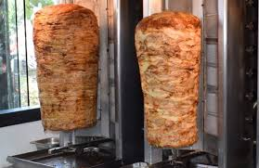
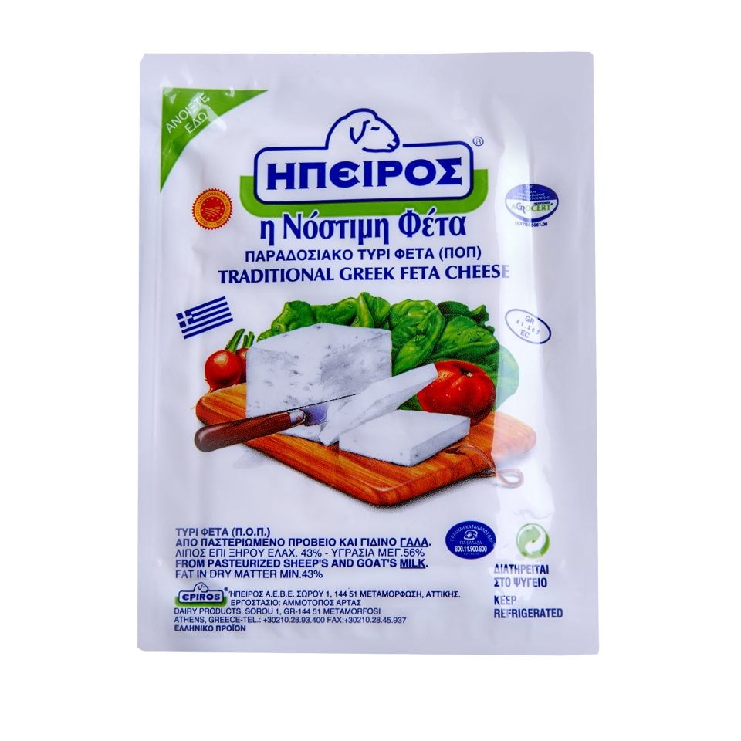
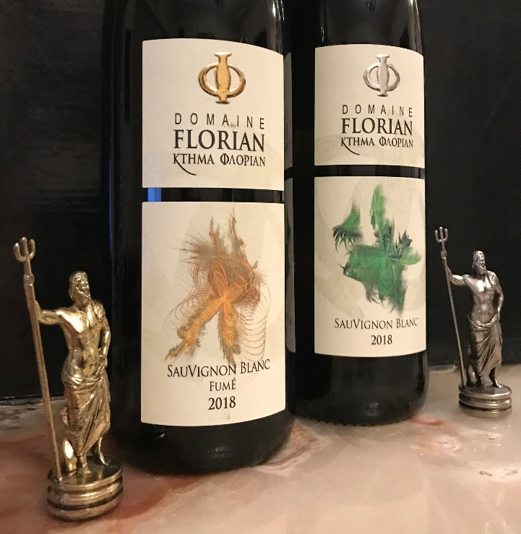
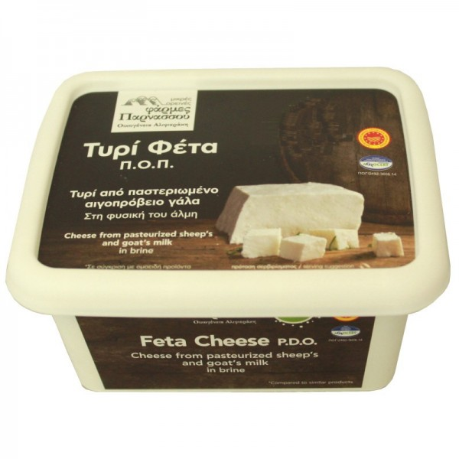
Accepted ...but:
a. pertain to the specific product
b. the trade mark statement should be clearly indicate the product's status as being PDO or PGI or TSG or that of a product with traditional terms for wine.
Accepted ... but:
a. pertain to the specific product
b. the trade mark statement should be clearly indicate the product's status as being PDO or PGI or TSG or that of a product with traditional terms for wine.

Slide 17
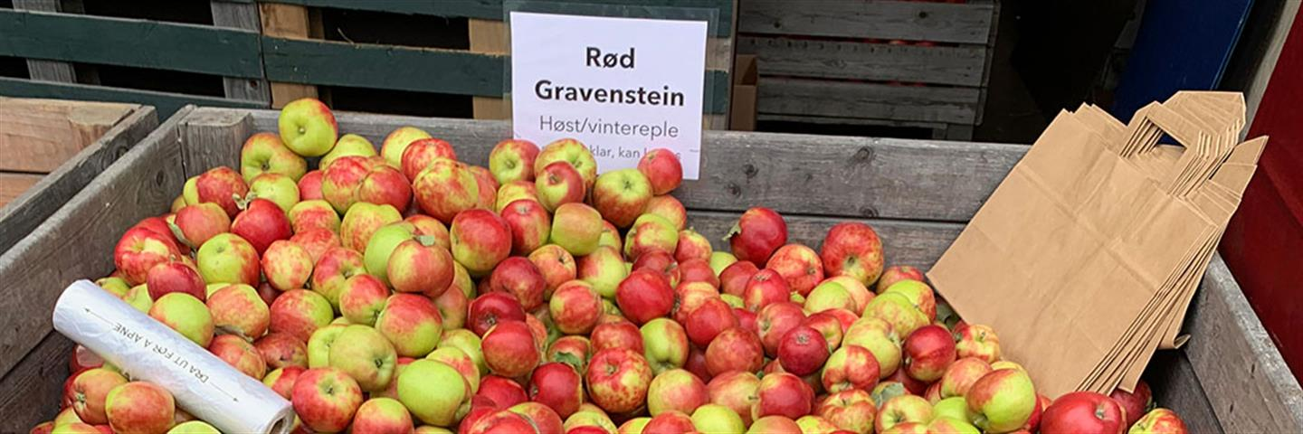
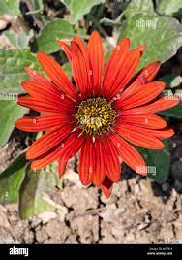
5. ...NOT those which consist of, or reproduce in their essential elements, an earlier plant variety denomination registered in accordance with Greek or Union legislation or international agreements to which Greece or the Union is party, providing protection for plant variety rights, and which are in respect of plant varieties of the same or closely related species (art. 4 (1)(l), L.4679/2020).
Family Genus Species Variety
E.g.: Application for the trade mark HANNAH for plants
ΗΑΝΝΑΗ is the plant variety denomination for Gerbera L.
Genus = Gerbera
Thus it shall be limited to products outside of the genus of the scientific name of the plant variety, which covers closely related species, i.e. “Plants outside of the Gerbera genus”.

Slide 18
6. Elimination of the ex officio examination of relative grounds for refusal (earlier trade marks)
Examination SOLELY for absolute grounds of refusal = majority of EU member states.
Purpose: to approve trade marks that are used in practice and not to be precluded by earlier trade marks which may be inactive

Slide 19




Researchers notify beneficiaries / applicants of earlier trade marks about identical/similar trade marks being filed
possible opposition or invalidity application or counterclaim in civil courts (art. 5, par. 1 L4679/ 2020).
vs
$$=$$
Visual, phonetic, conceptual comparison of new kinds of trade marks with the same or other earlier similar or identical trade marks

Slide 20

7. The product/service class title (Nice Classification) in the trade mark application covers only products / services that fall under the literal meaning of the class heading and not necessarily those included in the alphabetical list of the category (art. 23, par. 4 of L.4679/ 2020)

Slide 21


Slide 22

Thank you

