Slide 1

Highlights from the Boards of Appeal
Sven STÜRMANN
President of the EUIPO Boards of Appeal
Seminar for IP Practitioners, Athens
5 October 2026

Slide 2
Boards of Appeal (BoA)
BoA Operations Area (BAOA)
EUIPO Mediation Centre
S. STÜRMANN
President
N. VIGNERON
Director
K. KUHL
Director
BoA Cabinet
Registry
K. ZAJFERT
Head of Service, Registrar
Alternative Dispute Resolution (ADR)
A. KUSTUROVIC
Head of Cabinet
Litigation
J. SORIANO
Head of Service
Presidium
D. HANF
Head of Service
Grand Board of Appeal
Knowledge and Information support (KIS)
S. BESLIER
Head of Service
1st Board of Appeal (EUTM)
2nd Board of Appeal (EUTM)
3rd Board of Appeal (RCD)
4th Board of Appeal (EUTM)
5th Board of Appeal (EUTM)
G. HUMPHREYS
Chairperson
C. NEGRO
Chairperson
G. HUMPHREYS
Chairperson
N. KORJUS
Chairperson
V. MELGAR
Chairperson
  M. BRA
  E. FINK
  C. BARTOS
  A. GONZÁLEZ
  H. SALMI
  S. MARTIN
  K. GUZDEK
  A. SÖDER
  M. BRA
  H. SALMI
  E. FINK
  C. BARTOS
  C. NEGRO
  S. RIZZO
  A. POHLMANN
  A. GONZÁLEZ
  J-K. GOVERS
  A. KRALIK
  J. JIMÉNEZ
  H. O’NEILL
  P. VON KAPFF
  A. POHLMANN
  R. OCQUET
  S. RIZZO

Slide 3
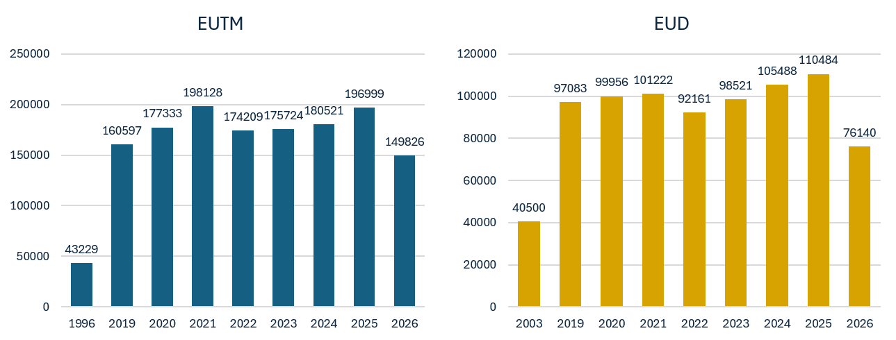
EUTM and EU Design filings at EUIPO
Source: https://www.euipo.europa.eu/en/about-us/the-office/what-we-do/statistics
Data until end of September 2026
Notes:
I would like to start my presentation by providing you some figures. On the following slide, you can see the statistics for EUTM and design (RCDa t the EUIPO for the past five years). By end of December this year, we had received 196886 EUTM applications and 110320 Design. You can see a continued growing trend for both IP products since 2023

Slide 4
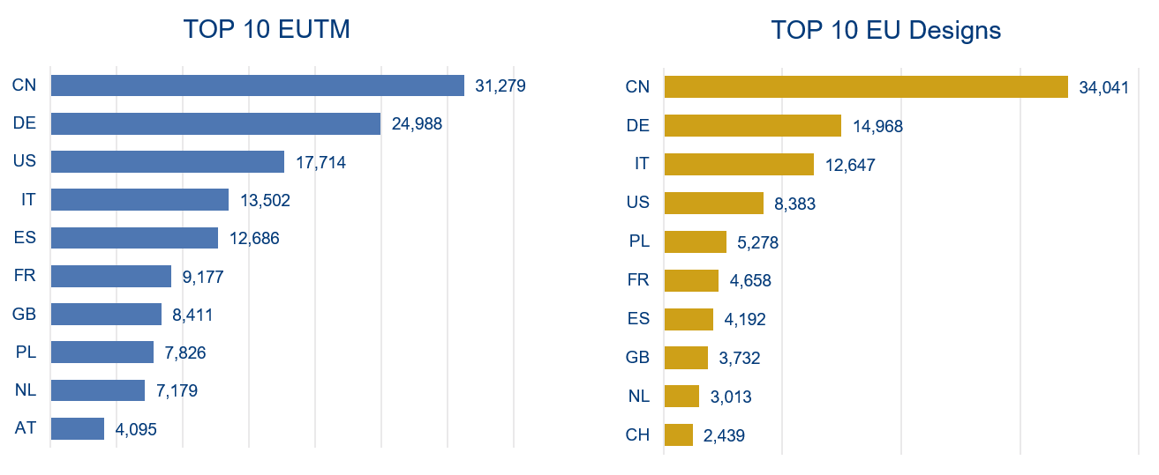
EUTM and Design applications in 2025
Source: https://www.euipo.europa.eu/en/about-us/the-office/what-we-do/statistics
Data until end of December 2025
Notes:
As you can see on this slide, China and Germany continue as top filers of EUTM and Designs in 2025. In 3rd place for EUTM is the US whereas for Designs is Italy.

Slide 5
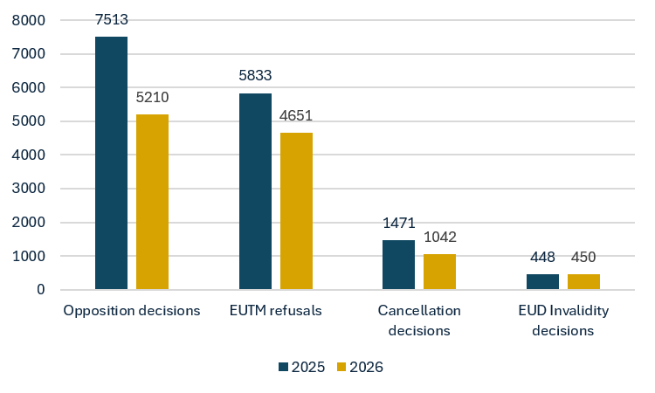
1st Instance volumes 2025 & 2026
Data until end of September 2026

Slide 6
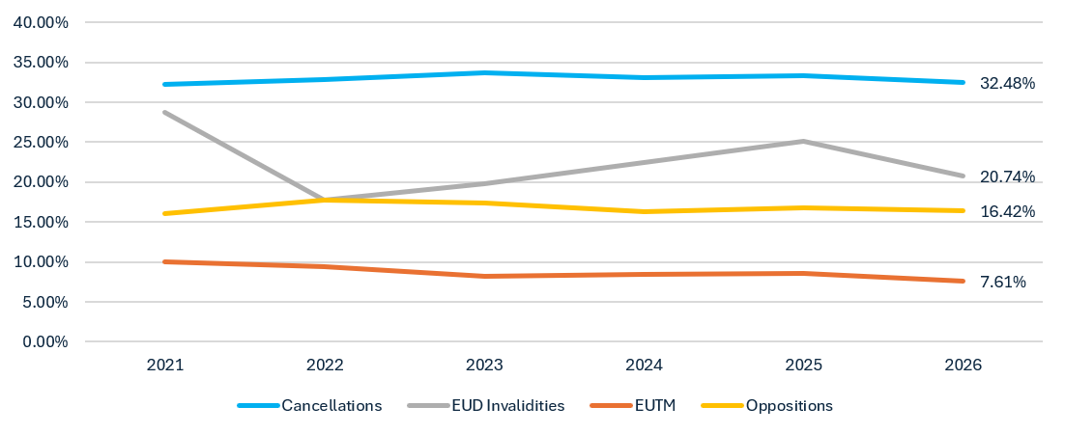
Appeal Rate 1st Instance decisions last years
Data until end of September 2026

Slide 7
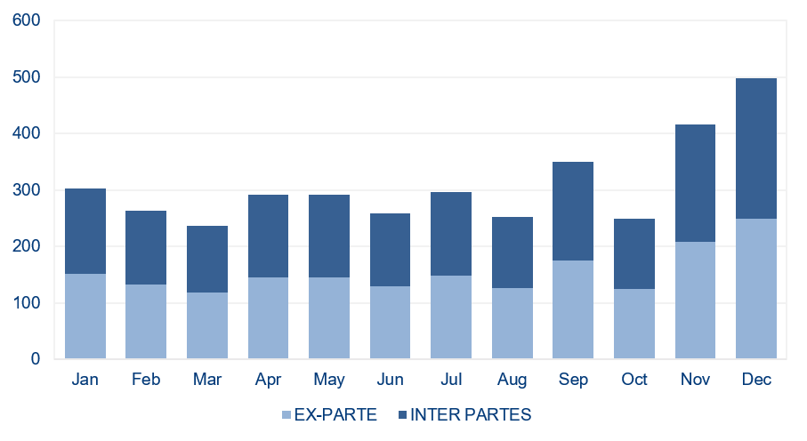
Appeals filed in 2025
Appeals filed
+ 4.6%
Total: 2475
EX PARTE
622 (25.1%)
INTER PARTES
1853 (74.9%)
EUTM
Total: 2362
EUD
Total: 113
Data until end of December 2025

Slide 8
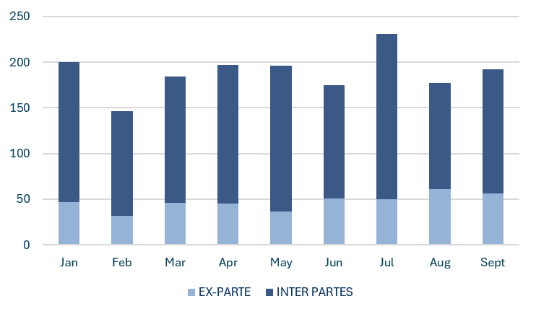
Appeals filed in 2026
Appeals filed
- 2.9%
Total: 1698
EX PARTE
424 (25%)
INTER PARTES
1274 (75%)
EUTM
Total: 1617
EUD
Total: 81
Data until end of September 2026

Slide 9
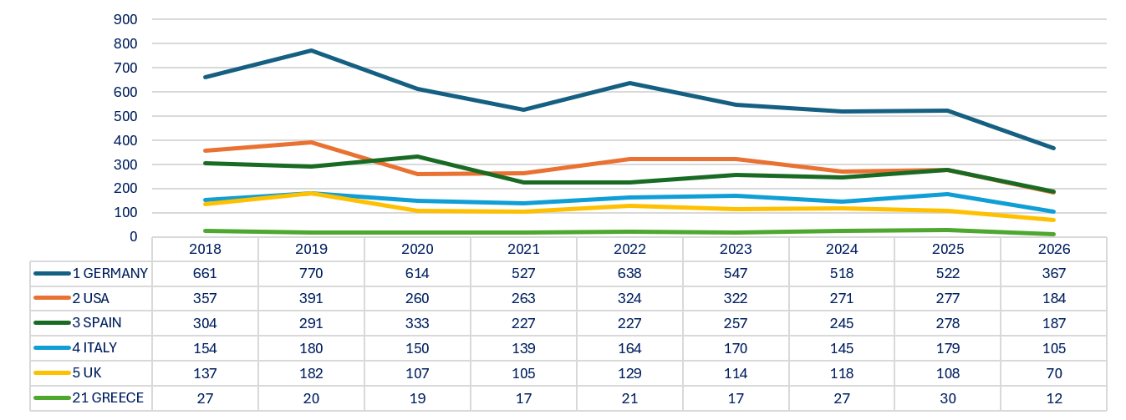
Evolution of appeal filings by Top 5 countries + Greece
Data until end of September 2026

Slide 10
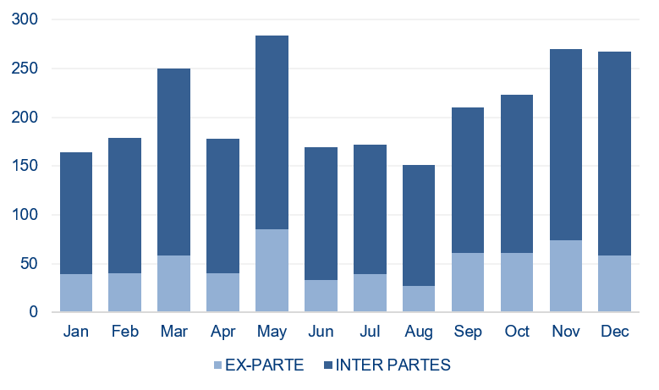
Decisions notified in 2025
Decisions notified
- 4.9%
Total: 2517
EX PARTE
615 (24.4%)
INTER PARTES
1902 (75.6%)
EUTM
Total: 2428
EUD
Total: 89
Data until end of December 2025

Slide 11
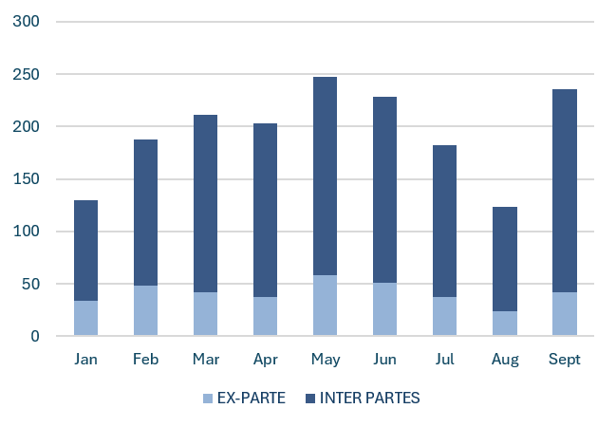
Decisions notified in 2026
Decisions notified
1748
Total
EX PARTE
373 (21.3%)
INTER PARTES
1375 (78.7%)
EUTM
Total: 1652
EUD
Total: 96
Data until end of September 2026

Slide 12
Workload – Appeals filed by language
Data until end of September 2026

Slide 13
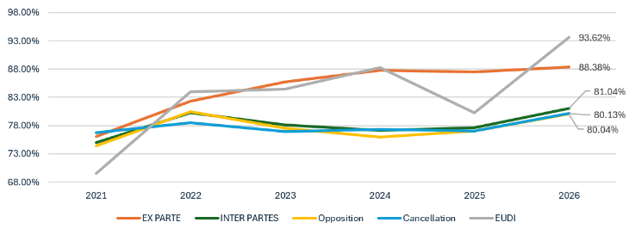
1st instance decisions confirmed by the Boards
Data until end of September 2026

Slide 14
Grand Board of Appeal
Composition: BoA President, 4 Chairpersons, 4 BoA Members (rotating)
Decisions of the Grand Board are binding for individual Boards.
Referral to the Grand Board:
  Legal difficulty
  Importance of the particular case or circumstances
  Divergent case-law
Referral by an individual Board or by the Presidium
Amicus curae possibility for trade or professional associations (e.g. INTA)

Slide 15
Grand Board of Appeal
56 | Decisions taken
5 | Decisions issued in the past 12 months
2 | Case currently pending
Figures by mid June

Slide 16
Latest decisions by the Grand Board of Appeal
2248/2019-G, GEORGE ORWELL
The sign is descriptive and non-distinctive because the relevant public in Ireland and Malta will immediately understand it as the name of the famous author and, in relation to the goods and services in Classes 9, 16 and 41, as indicating their subject matter (i.e. works by him or content related to him).
R 1719/2019-G, ANIMAL FARM & R 1922/2019-G, 1984
The signs corresponding to the titles of famous books will be perceived as indicating the subject matter of the goods and services in Classes 9, 16, 28, and 41, thereby rendering the signs descriptive and non-distinctive under Art. 7(1)(b) and 7(1)(c) EUTMR.
Filing an application for an EUTM at an early stage, prior to the applicant’s name or the title of a work becomes widely known, may preclude the application of Art. 7(1)(b) and (c) EUTMR, insofar as the sign would not yet be perceived by the relevant public as descriptive or devoid of distinctive character.

Slide 17



Pending cases before the Grand Board of Appeal
Clarity and precision of the term software under Article 33(2) EUTMR and the assessment of similarity between software and motor vehicles
(17/09/2026, R 1989/2025-1, KIRA (fig.) / QIRA)
Pending

Slide 18
Litigation – Appeal rate
2026
Decisions final at BoA
90 %
Appeal rate
9.7 %
EX PARTE
8%
INTER PARTES
10.2%
2025
Appeal rate
9.8 %
EUTM
9.6%
EUD
16.8%
Data until end of September 2026
Notes:
As regards the quality of the products of Board of Appeal decisions, as you know, we use two criteria, namely, the percentage of decisions against which an appeal is lodged before the GC and CJ (‘appeal rate against BoA decisions’), and also the Confirmation Rate of our decisions by these two higher instances.
As regards the first of these criteria - the Appeal Rate of BoA decisions - in 2025 it iwas trending at around 10%, meaning that the majority of decisions of the Boards of Appeal are final – almost 90% - and only a small fraction is challenged before the GC, and an even smaller number before the CJ.
This is an important indicator since it tells us that the Boards are fulfilling their filtering role within the EU IP dispute resolution system

Slide 19
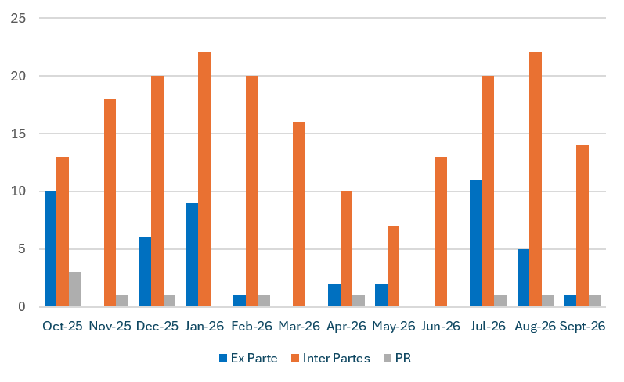
Litigation – Activities before the EU courts last 12 months
Litigation activities
2026
GC cases: 175
CJ cases: 19
Preliminary rulings: 5
Oral hearings: 67
Litigation activities
2025
GC cases: 254
CJ cases: 39
Preliminary rulings: 11
Oral hearings: 86
Data until end of September 2026

Slide 20
Litigation – Confirmation rate of BoA decisions by GC last 12 months
Confirmation rate
Confirmed at the Boards
84.7%
Data until end of September 2026

Slide 21
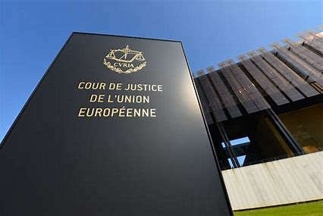
Litigation – Activities before the Court of Justice
Since 2019, 286 appeals to Court of Justice rejected but only 8 admitted:
Filed by EUIPO
10/12/2021, C-382/21 P, EUIPO v KaiKai: appeal upheld (27/02/2024)
07/04/2022, C-801/21 P, EUIPO v Indo European Foods (‘Basmati’):
appeal dismissed (20/06/2024)
11/07/2023, C-93/23 P, EUIPO v Neoperl, appeal upheld (23/01/2025)
16/11/2022, C-337/22 P, EUIPO v Nowhere (APE TEES) appeal upheld (05/02/2026)
18/11/2025, C-411/25 P, EUIPO v Versiontech (pending)
Filed by parties to EUIPO-proceedings
30/01/2023, C-580/22P, bonnanwalt v EUIPO: appeal upheld (30/01/2024)
08/05/2023, C-776/22 P Ughi e Nunziante v EUIPO: appeal upheld (04/09/2025)
18/04/2023, C-751/22 P, Shopify Inc v EUIPO (pending)
Updated on 30 September 2026

Slide 22

Alternative Dispute Resolution – EUIPO Mediation Centre (EMC)
Mediation
Conciliation
Friendly Settlement

Slide 23
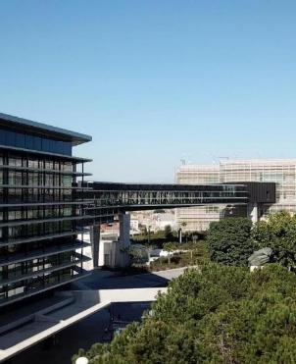
The EUIPO Mediation Centre (EMC)
  Launched in November 2023 - The EMC is managed by the ADR Service of the Boards of Appeal (BoA) and builds on the BoA’s mediation experience since 2011.
  Objective
  To provide complementary, voluntary, confidential and accessible dispute resolution options to users so that they can choose the most appropriate path in the event of an IP dispute.
  Legal basis
  Article 170 EUTMR
  Decision ADM-23-45 on the Establishment and Operation of the Mediation Centre

Slide 24
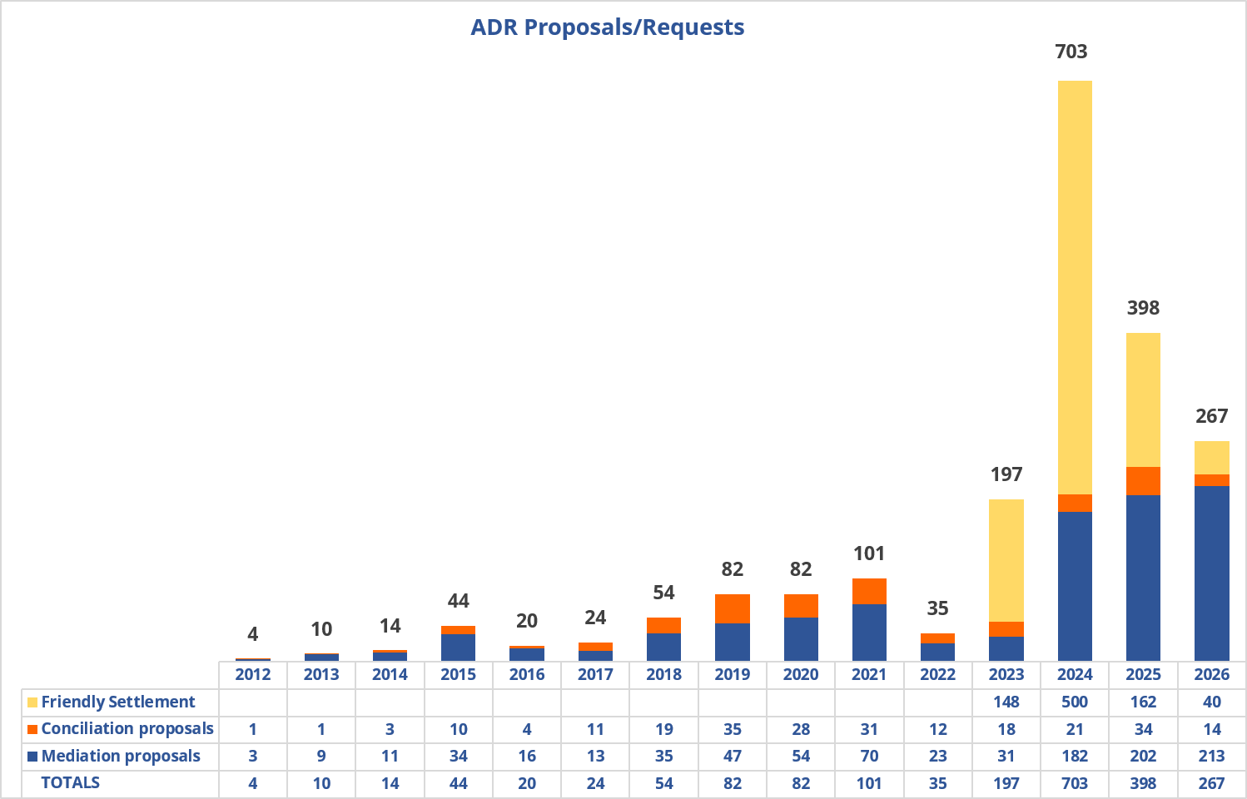
ADR volumes
January to date 2026
267 ADR proposals
Mediation Proposals by origin:
20% direct request from parties
37% from first instance
43% from second instance
Data until 1 October 2026

Slide 25
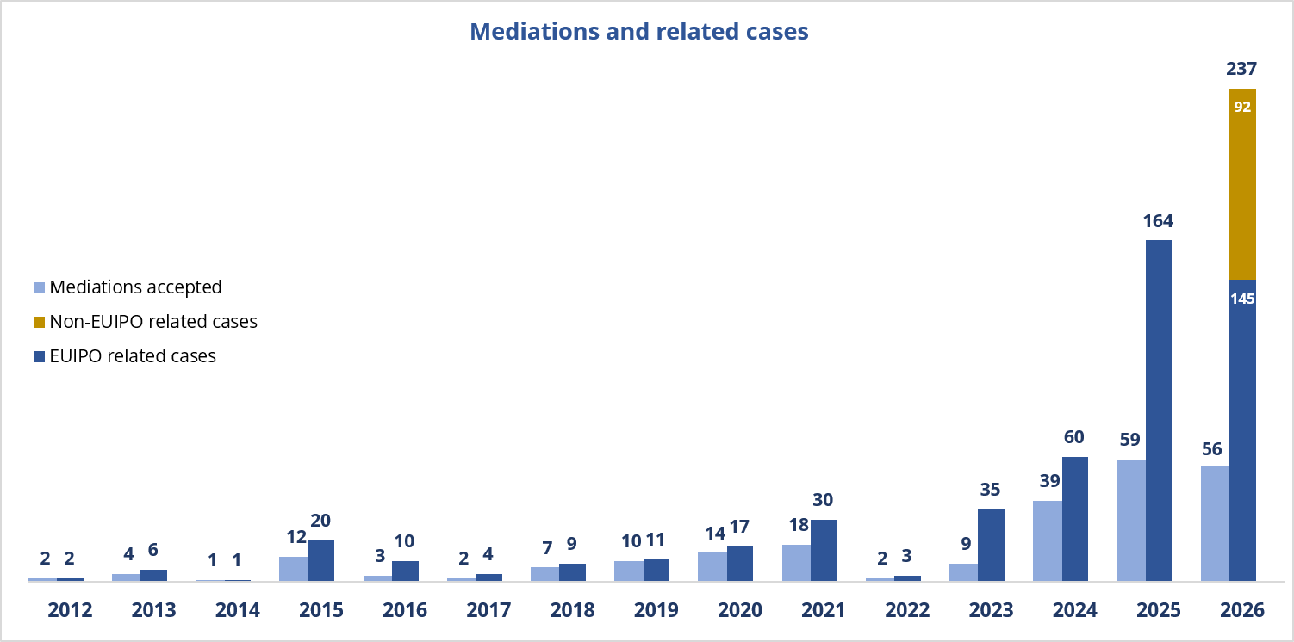
Mediations and related cases
Resolving multiple interconnected disputes within a single process
70% Settlement rate
94% User satisfaction post-mediation
  Mediation at the Boards of Appeal
  2nd instance
  Launch of the Mediation Centre
Data until 1 October 2026

Slide 26
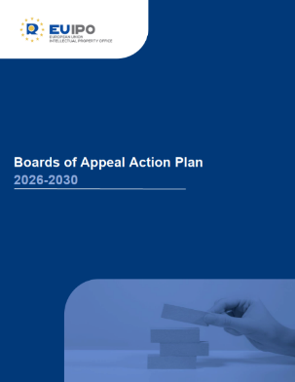
Boards of Appeal Action Plan 2026-2030

Slide 27

Vision
Offer full range of dispute resolutions through holistic 360° case management
Ensuring quality through timely, consistent and predictable dispute resolution
Mutual development through cooperation
Value Driven Dispute Resolution
Making the Boards a reference point
User centric approach ensuring easy access to dispute resolution tool
One Stop IP Dispute Resolution Hub

Slide 28
Artificial intelligence and new Boards of Appeal Action Plan
Adoption and leadership of artificial intelligence (‘AI’) in decision-drafting
Engage with selected AI initiatives, enhancing search, effective drafting assistance and consistency of decision drafting while safeguarding judicial independence and fundamental procedural rights
Become a reference point on the use of AI for the appeal bodies of the national and regional IPOs and for the national IP courts
Human-centric approach to AI
Commitment to ethical and responsible AI

Slide 29
Enhancing Quality and Trust while safeguarding independence
Reinforce quality of decisions by using a clearer and more concise language
Review Boards of Appeal Rules of Procedure, appeal working instructions and practices, with the aim of simplifying proceedings and thus reducing procedural burden for parties
Commission a study on the optimal characteristics of high-quality decisions
Ensure efficient handling of appeals
Identify at an early stage the best way to resolve an appeal case:
Investigate use of AI: to support decision drafting, increase consistency, and enhance user experience
Introduce User Feedback on Decisions (related to Key Action Strengthen dialogue with users and their associations)
Key Action:
Quality assurance
and holistic case management
New Appeal
Decision
Expedited Appeal Proceedings
Grand Board
Oral Hearing
Mediation
Conciliation

Slide 30

Enhancing Quality and Trust while safeguarding Independence
New Case-Law Analysis Tracking System (CATS)
Identify trends in the Boards of Appeal, General Court, and Court of Justice case law. As a second phase, once Case Law View is fully operational, to include national case law (linked with Key Action Move from eSearch Case Law to Case Law View)
Also looking at the Boards of Appeal case law research reports and EU Common Practices
Flag legal areas of particular importance to identify potential Grand Board cases and preliminary ruling requests by the national IP courts (related to Key Action Convert the IP Judges Network into an IP Judges Community) and inform the entire IP Community
Share information with other EUIPO departments and with national and regional IPOs, national IP courts and users
Explore use of AI to support the CATS model

Slide 31
Enhancing Quality and Trust while safeguarding Independence
Revision of the Consistency Circle workflow and Terms of Reference to enhance efficiency
Draft new and update existing Boards of Appeal case-law research reports
Promote case-law research reports with the EU IP Network
Interaction with users on possible new topics for the
case-law research reports (related to Key Action Strengthen dialogue with users and their associations)
Key Action:
Maintain and exploit the impact of Consistency Circles

Slide 32

Consistency Circles (CC)
CC Absolute Grounds
CC Relative Grounds
CC Goods and Services
CC Designs
CC Procedure and Registry
CC Geographical Indications
→ identify case-law trends and detect possible divergences
→ ensure a transparent (non-binding) legal debate and a collaborative review of case-law
→ support consistency, quality, predictability of BoA decisions and proceedings practice
→ support to Grand Board

Slide 33

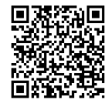
Case-law Research Reports / Consistency Circles
Latest reports published (35 in total)
Signs describing the subject matter of goods and services
Defining the scope of the indications of goods and services in trade mark specifications
Invalidity of a design dictated by its technical function pursuant to Article 9(1) EUDR (update)
New topics in the pipeline …
Family of marks
Evocation of geographical indications
These reports are the result of discussions within the Consistency Circles and the General Consistency Meeting of the Boards of Appeal and reflect the views at the given date. They are working documents and should not be considered to have any binding effect on the Boards of Appeal.

Slide 34
Taking Mediation to the next level
Establish a Mediation Community with national and regional IPOs
and IP courts
Make mediation available in the entire EU IP Community
Provide global and sustainable solutions to IP disputes contributing to innovation and growth
Develop a system to identify related cases at EU and national level
Pilot initiatives with national and regional IPOs to enhance further cooperation activities in mediation
Pilot initiatives with EUTM/EUD Courts to develop a practical workflow for referring disputes to the EUIPO Mediation Centre
Next IP Mediation Conference in 2027 and 2029
Key Action:
Bring mediation to the EU IP Community

Slide 35
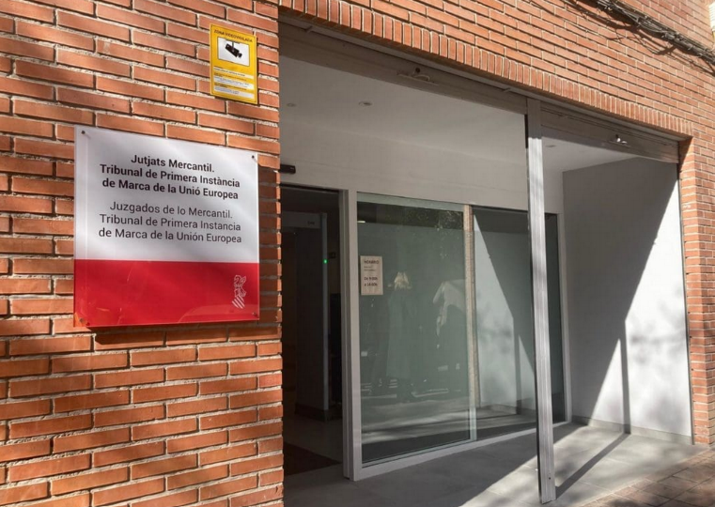
Pilot project with EUTM/EUD Courts
EUTM/EUD Courts will be able to refer disputes to the EUIPO Mediation Centre
Pilot project with EUTM/EUD Courts to develop a practical workflow
  Kick off in 2026 - EUTM/EUD 1st instance court of Alicante
                the court suggest mediation
              if the parties agree – Court suggests to parties to consider mediation at the EUIPO Mediation Centre

Slide 36
Accessibility and Visibility
One direct access to all relevant Boards of Appeal information and documents
Create a centralised and user-friendly appeal compendium documentation tool
Explore the possibilities of AI to support the appeal compendium to allow user friendly searches such as intelligent search and automated cross-referencing.
Phased approach: starting with internal stakeholders (Boards of Appeal staff and EUIPO departments) and at a later stage external stakeholders
Key Action:
Establishment of an appeal compendium documentation tool

Slide 37

Accessibility and Visibility
Transform eSearch Case Law into an added value database that also contains all decisions from national and regional IPOs and their appeal bodies and court judgments deciding on national and EU trade marks and designs
Further improvement of machine translation quality
Involve users and leverage AI to optimise search results
Key Action:
Move from eSearch Case Law to Case-Law View

Slide 38
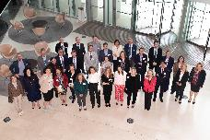
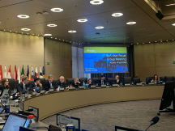
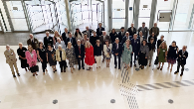
Partnership and Growth: External stakeholders
IP Judges Community
A Community of national IP judges from EUTM and RCD national courts to review the quality of EU and national IP legal practices and identify and discuss trends in IP jurisprudence.
European Cooperation Projects
The EU IP Offices and User Associations cooperate on projects to harmonise practices and standards. The aim is to develop and implement common principles based on relevant EU and national Court judgments.
NETWORK OF APPEAL BODIES
A forum of Appeal Bodies of EU IPOs to discuss trends in EU trade mark and design legal practices and procedures, including analysis of recent Boards of Appeal and national case-law.
User Focus Group
A Network of User Associations´ representatives focused on discussions on case-law and its implications, and consultations on specific topics crucial to the users.

Slide 39
IP Judges Community
Assemble national judges from all instances of all Member States EUTM and EUD courts into an IP Judges Community
Establish IP Judges Community as a forum where legal areas of particular importance can be discussed, including potential preliminary ruling requests and Grand Board cases identified through Key Action Case-law Analysis Tracking System (CATS)
Create group of national IP Judge Ambassadors for each Member State
Create a digital platform for knowledge sharing for the IP Judges Community
Establish a network of academic institutions to support IP Judges Community
Key Action:
Convert the IP Judges Network into an IP Judges Community

Slide 40

IP Judges Community: IP Judges Ambassadors
The group of national IP Judges Ambassadors for each Member State
    Objective: Enhance the level of harmonization
    Contact points between those judges who attend the IP Judges Community Meetings in Alicante and all other IP judges in the various Members States.
    Report to national judges on the regular Community meetings
      Share the key points of discussion, as well as the main conclusions, recommendations,
      Provide the documents and information exchanged during the meetings.
    Organise seminars with the judges every two years when we visit the National IPOs
    Help to disseminate information to all member of the Community about
      National case law
      CJEU/GC case law
      Preliminary rulings
      Board of Appeal case law
      Boards of Appeal events
      Case Law Research Reports
      Common Practices

Slide 41
National and Regional IPOs
Intensify collaboration with national and regional IPOs and their appeal bodies
Biannual workshops and interactive roundtable discussions
Encourage national and regional IPOs to submit observations to pending Grand Board cases
Involve the Network of Appeal Bodies of national and regional IPOs in discussions on the results of the study on optimal characteristics of high-quality decisions to identify best practices on decision quality
Key Action:
Strengthening partnerships with IPOs and their appeal bodies

Slide 42
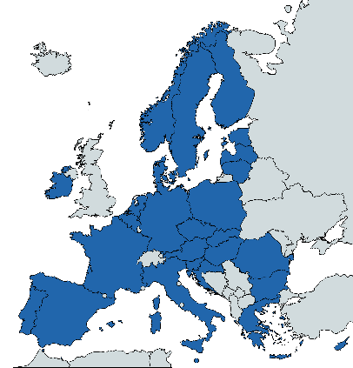
National and Regional IPOs – Visits and seminars
Since 2015, the Boards of Appeal has organised regional seminars for IP practitioners and IP judges together with bilateral meetings with IPOs and IP Courts
124 visits to 26 countries
7
2
2
7
5
4
6
3
Promotion and awareness of EU Appeal System and BoA activities to regional IP stakeholders
Presenting recent BoA case-law and discussion on trends in trademark and design practice
Promotion and awareness of Alternative dispute resolution (EUIPO Mediation Centre)
6
3
6
5
3
2
3
4
2
3
4
2
4
1
8
4
5
4

Slide 43
Users
Continue with the User Focus Group Meetings to discuss appeal related matters and to jointly identify trends in practices and case-law
Continue organising interactive in person and hybrid events (so-called ‘Tertulias’) in Alicante, Brussels and Luxembourg to foster regular dialogue with users on the Boards of Appeal case-law and activities
Enhance the interaction with user associations within the framework of activities of the Boards of Appeal Consistency Circles
New regional user sessions, thematic webinars, interactive Q&A sessions and feedback forums on case-law trends
Introduce User Feedback on Decisions and strengthen dialogue with users with the aim of improving quality based on the study on optimal characteristics of high-quality decisions and User Focus Group Meetings
Create best practices on written submissions in appeal proceedings (statements of grounds, observations, etc.)
Key Action:
Strengthen dialogue with users and their associations

Slide 44

User Feedback Exercise
User Feedback on BoA Decisions is a new initiative launched in response to several requests from User Associations and following in-depth reflection by the Boards in the context of the new Action Plan 2030.
Basis: Study on the Quality of Administrative Decisions 2025.
The purpose of this initiative is to foster an open dialogue with users while fully respecting the independent nature of the Boards.
Study on Evaluation of Optimal Quality of Administrative Decisions
Notes:
All feedback received will be duly considered. However, unlike SQUAP, the panel is not intended to serve as a structured quality audit.

Slide 45
Collaboration and Innovation within the Boards of Appeal
Enhance efficient internal communication
Encourage cross-functional dialogue
Enhance inclusivity and workplace culture
Enhance AI, digital and case management skills
Focus on upskilling and reskilling of Boards of Appeal staff, in particular in the area of AI and new technologies
Cross training initiatives (job-shadowing, coaching, mentoring)
Support solidarity projects for the local Alicante community
Key Action:
Promote the culture of collaboration and innovation

Slide 46

Highlights for 2027
30 Anniversary of the Boards of Appeal
15 years of IP Mediation at the EUIPO
IP Mediation Conference – 12 and 13 April 2027

Slide 47
Further reading
eSearch Case Law: https://euipo.europa.eu/eSearchCLW/
Grand Board decisions and pending cases: https://www.euipo.europa.eu/en/the-office/boards-of-appeal/decisions
Boards of Appeal Case-Law Research Reports: https://www.euipo.europa.eu/en/the-office/boards-of-appeal/publications/research-reports
Overview of Boards of Appeal decisions: https://www.euipo.europa.eu/en/the-office/boards-of-appeal/publications/decisions
Overview of GC/CJ Case-Law: https://www.euipo.europa.eu/en/the-office/boards-of-appeal/publications/cjgc-case-law
Boards of Appeal Studies: https://www.euipo.europa.eu/en/boards-of-appeal/studies
BoA Action Plan: https://www.euipo.europa.eu/en/boards-of-appeal/action-plan

Slide 48
Thank you for your attention

