Slide 1
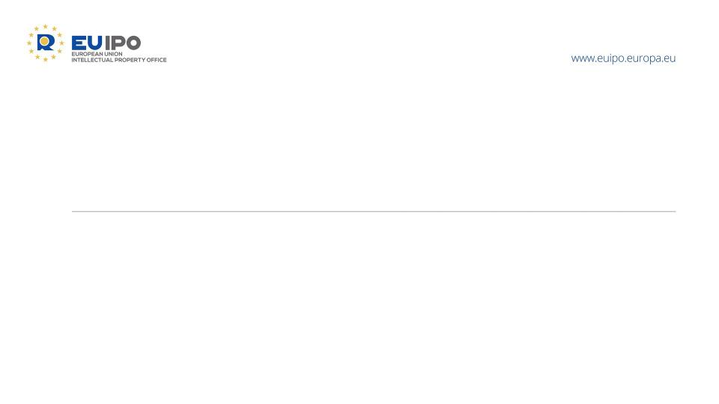
Recent Boards of Appeal case law,
including Grand Board decisions
Kinga GUZDEK
Member of the 2nd Board of Appeal
Seminar for IP Practitioners, Athens
5 October 2026

Slide 2

Overview of cases
Absolute grounds :
7(1)(b)(c)
19/12/2025, R 2248/2019‑G, GEORGE ORWELL
27/05/2026, R 1719/2019-G Animal Farm & R 1922/2019-G 1984
Relative grounds:
8(1)(b)
09/06/2026, R 2418/2025-2, ZENX (fig.) / ZEN
03/07/2026, R 1379/2025‑4, VOLTAP (fig.) / OILTAP et al.
04/03/2026, R 1295/2025-4, SWISSNOX / Swiss
8(5) - 12/12/2025, R 1568/2024‑2, DEVICE OF A STYLIZED GREEK KEY DESIGN IN A DIAMOND SHAPE (fig.) / DEVICE OF A BLACK SQUARE WITH ONE LINE PROJECTING IN THE INTERIOR OF THE SQUARE (fig.) et al.

Slide 3


19/12/2025, R 2248/2019-G, GEORGE ORWELL - appealed before the General Court (T-137/26)
GEORGE ORWELL
Descriptive of subject matter
Non-distinctive
Classes 9, 16 and 41 (recorded/digital media, printed matter, and entertainment/education-related services)
Applicant: heirs/owners of the rights to the name and works of George Orwell
Relevant EU public (at least English-speaking – Ireland and Malta) will immediately perceive ‘George Orwell’ as the well-known British writer
On the basis of non-exhaustive criteria (fame, dissemination and adaptation of works, cultural integration, persistence over time, and market reality), the name 'George Orwell' is commonly understood as referring to the content of cultural works
For the relevant goods and services, the name 'George Orwell' directly describes the subject matter pursuant to 7(1)(c)
Moreover, the author’s reputation prevents the public from perceiving the name as an indication of commercial origin - 7(1)(b)
Elements such as copyright, moral rights, or the identity of the applicant do not affect the assessment under Article 7 EUTMR
Previous diverging decisions justified referral to the Grand Board

Slide 4

27/05/2026, R 1719/2019-G Animal Farm & R 1922/2019-G 1984 - appealed before the General Court (T-524/26)
ANIMAL FARM
1984
Descriptive of subject matter
Non-distinctive
Classes 9, 16 and 41 + 28 (recorded/digital media, printed matter, entertainment/education-related services + games)
Applicant: heirs/owners of the rights to the name and works of George Orwell
Trade mark ≠ book title
Relevant EU public (English-speaking – Ireland and Malta) will immediately recognise the signs ‘ANIMAL FARM’ and ‘1984’ as the titles of famous novels by George Orwell, respectively a political allegory/fable and a political dystopian novel
This has been demonstrated by the novels’ widespread fame, their inclusion in educational curricula, and their enduring popularity over several decades + successful adaptations
‘ANIMAL FARM’ and ‘1984’ immediately describe the subject matter or content of political allegory or political fiction pursuant to 7(1)(c)
Moreover, the titles’ reputation prevents the public from perceiving them as an indication of commercial origin - 7(1)(b)
Copyright considerations do not affect the assessment under Article 7 EUTMR
Previous diverging decisions justified referral to the Grand Board

Slide 5


09/06/2026, R 2418/2025-2, ZENX (fig.) / ZEN- appeal period pending
ZEN
Earlier EUTM Class 34: Tobacco and tobacco products | Contested EUTMA Class 34: Tobacco and tobacco products
8(1)(b) EUTMR
Likelihood
of Confusion
(OD decision annulled)

Slide 6

03/07/2026, R 1379/2025‑4, VOLTAP (fig.) / OILTAP et al. - appeal period pending
OILTAP VACUTAP DEETAP ECOTAP
Earlier EUTMs Class 9: Electric apparatus and instruments for electrical engineering, namely for conducting, converting, storage, regulating and controlling, namely step switches, onload tap changers | Contested EUTMA Classes 9, 37, 41, 42
8(1)(b) EUTMR
Likelihood
of Confusion
- Family
of marks
(OD decision annulled)

Slide 7

04/03/2026, R 1295/2025-4, SWISSNOX / Swiss - final
Swiss | SWISSNOX
Earlier EU collective mark Class 14: Horological and chronometric instruments; watches; parts and fitting | Contested EUTMA Class 14: Wristwatches; bracelets; necklaces.
8(1)(b) EUTMR
No
Likelihood
of Confusion
- Weak distinctive character of the common element
(OD decision annulled)

Slide 8
Low distinctiveness – factual assessment
New BoA methodology: understanding of English in the EU · 2025
OVERRIDING PRINCIPLE
Knowledge of a foreign language by the relevant audience must be proven by the party on whom the burden of proof rests.
FOUR EXCEPTIONS — ENGLISH AS A MATTER OF COMMON KNOWLEDGE
1
A basic level in some EU countries
3
Close linguistic equivalent
A basic knowledge of English amongst the general public in certain Member States — e.g. in the Nordic countries and Cyprus.
The English term has a close equivalent in the language of non-English-speaking audiences, e.g. innowacja / innovazione / innovación / innovation
T‑498/21, Black Irish, para. 51
4
Recognition in the context of goods or services
2
Basic vocabulary across the EU
PROFESSIONAL AUDIENCES
Basic terms are understood throughout the Union. The CEFR level is key: A1/A2 words can be considered basic; at higher levels, other exceptions may apply.
They are familiar with sector-specific terminology — particularly in IT, finance and medicine.
T‑301/09, CITIGATE; T‑434/05, Activy Media Gateway; T‑513/13, SAFESET; T‑524/24, VC LAW / vklaw et al.
T‑602/21, good calories (fig.), para. 33; T‑209/24, North 56‑4 / 66°NORTH
GENERAL AUDIENCE
In connection with exposure, particularly in sectors such as entertainment, travel and tourism.
See, inter alia: T‑443/21, YOGA ALLIANCE INDIfig.) v yoga ALLIANCE (fig.); T‑30/23, flyPersia (fig.) v flydubai (fig.) and othersA INTERNATIONAL (.

Slide 9



12/12/2025, R 1568/2024‑2, DEVICE OF A STYLIZED GREEK KEY DESIGN IN A DIAMOND SHAPE (fig.) / DEVICE OF A BLACK SQUARE WITH ONE LINE PROJECTING IN THE INTERIOR OF THE SQUARE (fig.) et al. - final
Earlier EUTMs Highly reputed for perfumes in Class 3 | Contested IR (→ EU) Class 36: financial and investment services via partnering with brands to provide fractional ownership in luxury assets for investors
8(5)
Taking unfair advantage of reputation
(OD decision annulled)

Slide 10
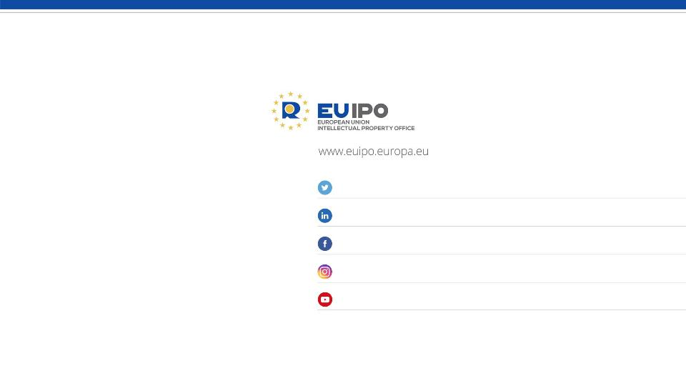
@EU_IPO
euipo
EUIPO.eu
@euipo
EUIPO
THANK YOU

