Slide 1
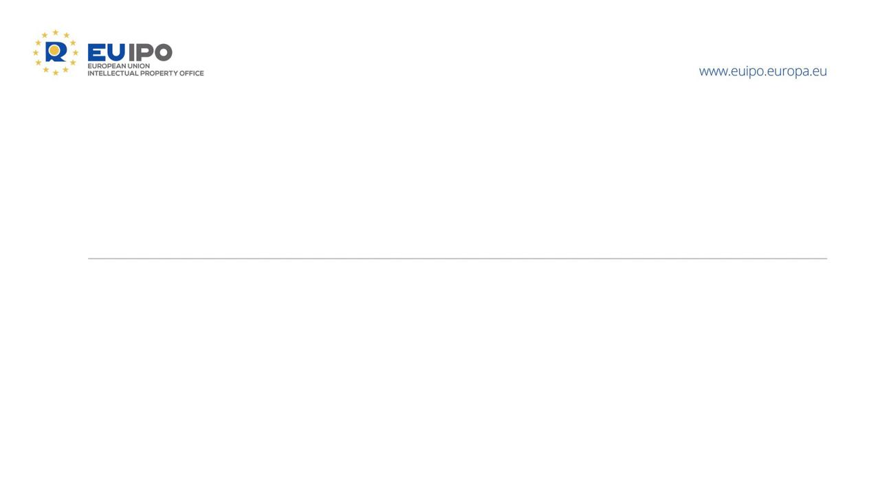
Recent Boards of Appeal case law on designs
and implications of the new EU Design Regulation
Sergio RIZZO
Member of the 3rd and 5th Boards of Appeal, EUIPO
Seminar for IP Practitioners, Athens
5 October 2026

Slide 2
INVALIDITY PROCEEDINGS
Definition of a design

Slide 3
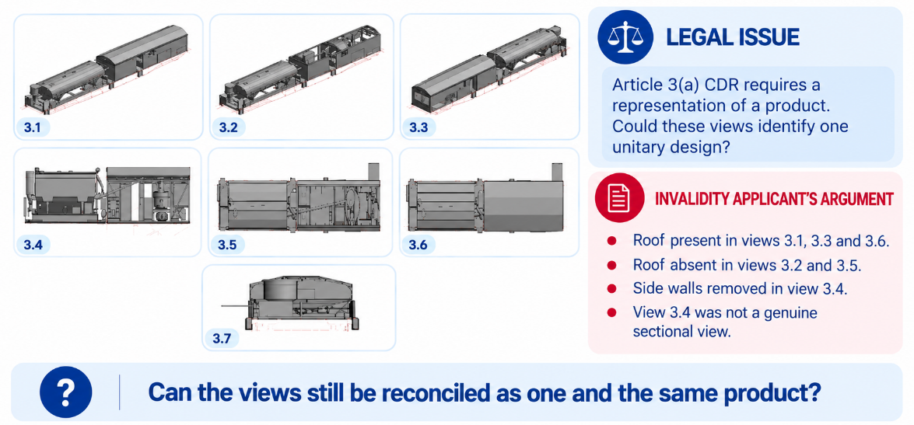
29/06/2026, R 1107/2025‑3, Installations for the production of concrete
Appealed before the General Court

Slide 4
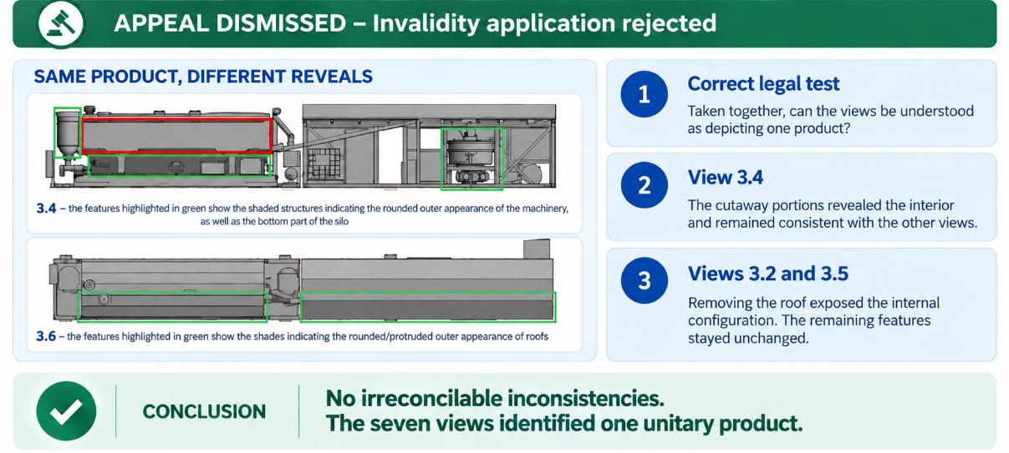
29/06/2026, R 1107/2025‑3, Installations for the production of concrete
Appealed before the General Court

Slide 5
INVALIDITY PROCEEDINGS
Proof of disclosure of an earlier design

Slide 6
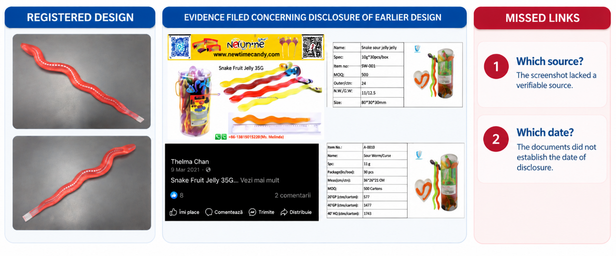
11/09/2026, R 0400/2026‑3, fruit jellies; packaging
Appeal period pending

Slide 7
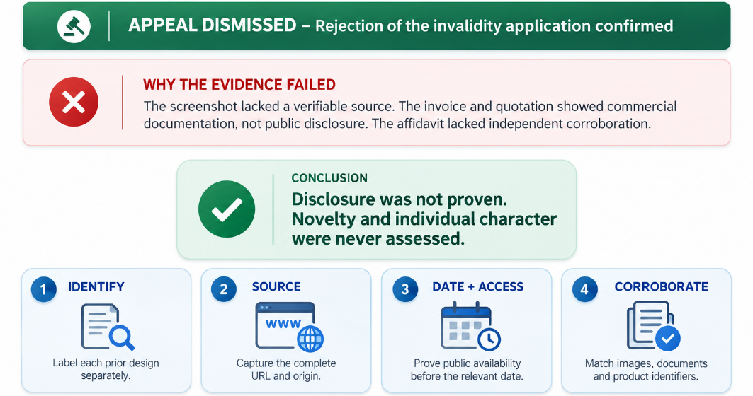
11/09/2026, R 0400/2026‑3, fruit jellies; packaging
Appeal period pending

Slide 8
INVALIDITY PROCEEDINGS
Novelty and individual character

Slide 9
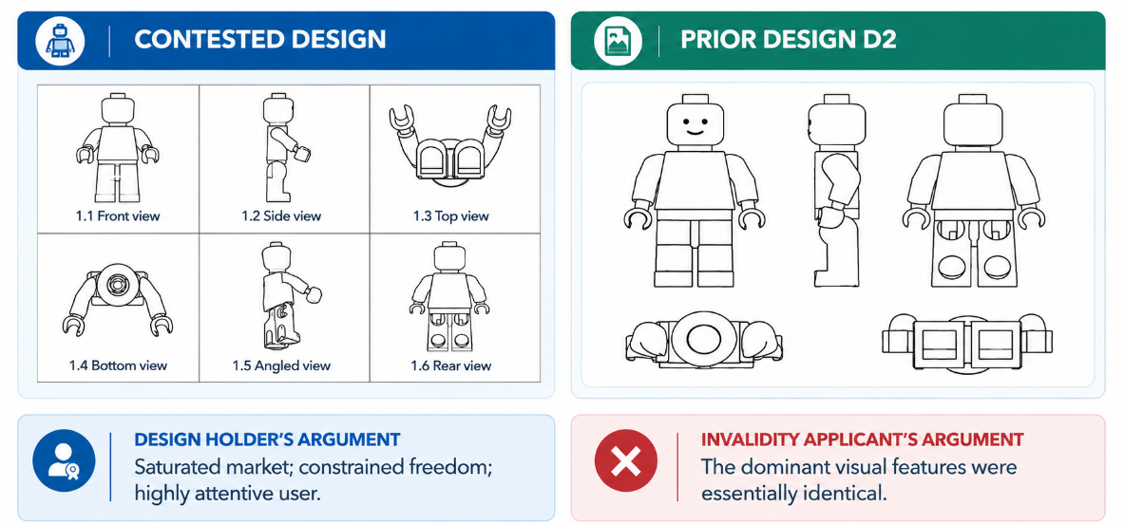
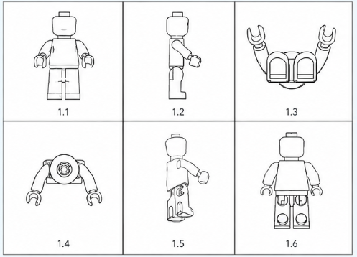
18/05/2026, R 0093/2025‑3, Figurines [toys]
Final

Slide 10
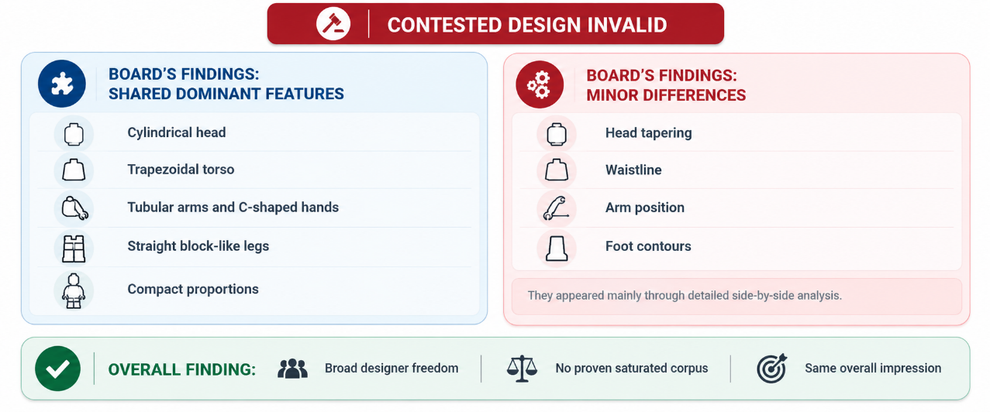
18/05/2026, R 0093/2025‑3, Figurines [toys]
Final

Slide 11
INVALIDITY PROCEEDINGS
Technical function of design

Slide 12
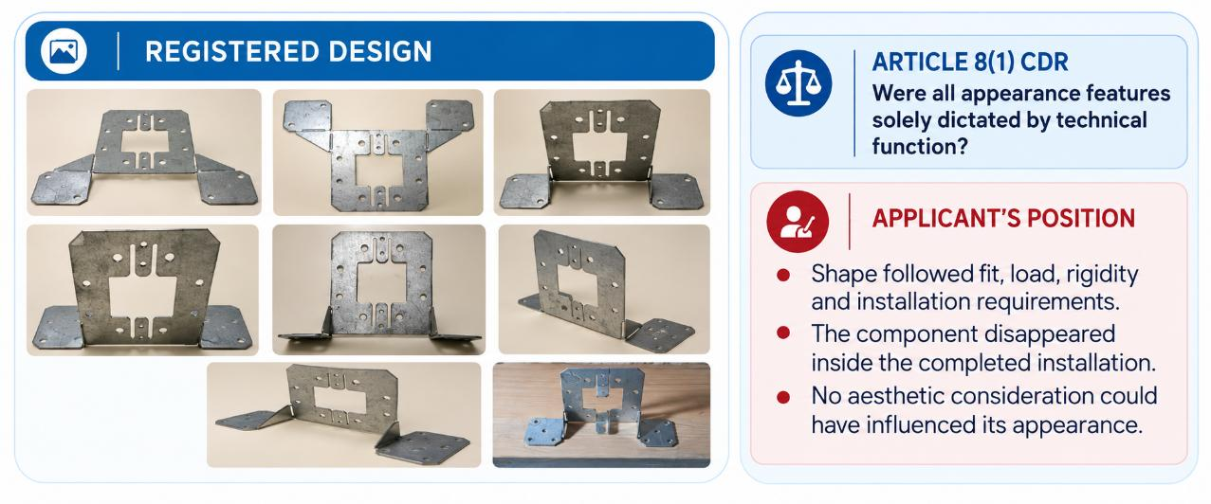
29/06/2026, R 1996/2025‑3, Fittings
Final

Slide 13
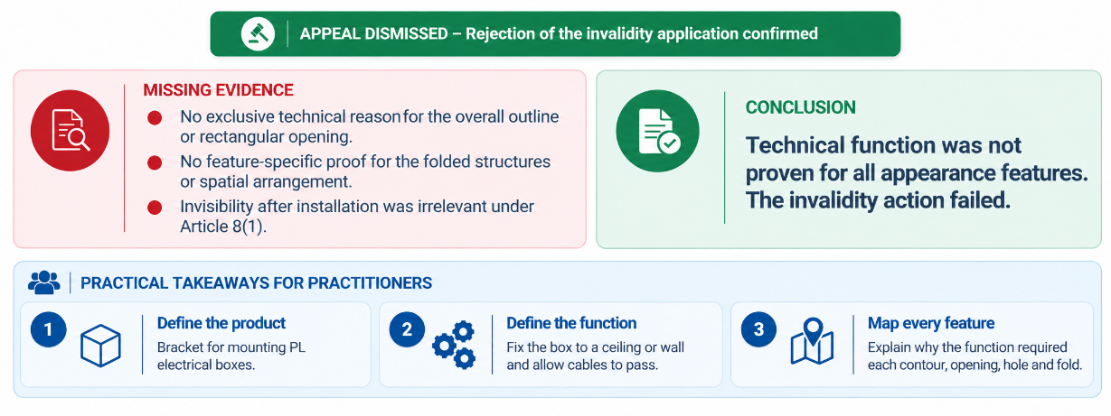
29/06/2026, R 1996/2025‑3, Fittings
Final

Slide 14
EU Design reform
What practitioners need to know

Slide 15
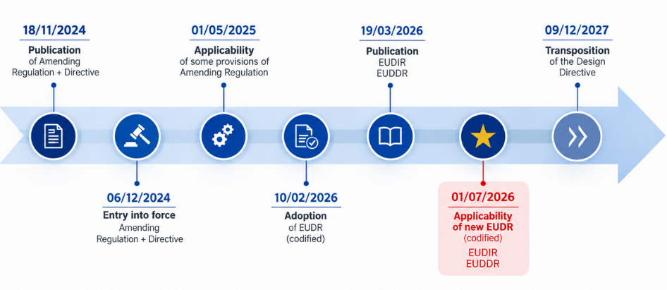
New EU Design law package
EU Design legislative reform
Today’s focus
What can now be protected
How filing practice changes
What changes in enforcement and invalidity
The immediate practitioner checklist
Notes:
The EU design reform is not simply a terminology update. It modernises what may be protected, changes how designs are represented and filed, and introduces new procedural tools.
For practitioners, the key date is 1 July 2026, when the codified EUDR and the new implementing and delegated regulations became applicable. In the next ten minutes, I will concentrate on the changes that affect day-to-day filing, portfolio and contentious practice.

Slide 16
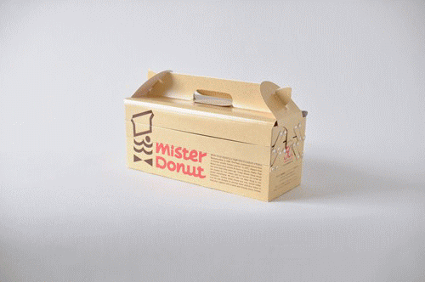


Object of protection
EU Design legislative reform
Design now expressly includes movement, transition and animation
Product may be physical or non-physical
Express coverage includes: GUIs and graphic symbols, logos and surface patterns, spatial arrangements, digital and animated products
Protection is determined by the features of appearance shown visibly in the application
Practitioner impact: representation strategy is more important than ever.
Notes:
The reform expressly accommodates contemporary design. A design may now include movement, transition or animation, and a product no longer needs to be embodied in a physical object. This brings graphical user interfaces, digital products and spatial arrangements clearly within the statutory language.
At the same time, Article 19 makes the representation decisive. Protection attaches to the features that are visibly shown. The practical question is therefore no longer only ‘what is the design?’, but also ‘have all the features for which protection is sought been represented clearly and consistently

Slide 17
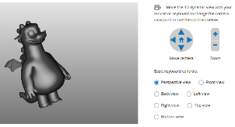


Filing practice: representation is the priority
EU Design legislative reform
New representation possibilities
  Static, dynamic or animated representations
  Drawings, photographs, video and computer modelling
  3D formats, including OBJ and STL
  Animated reproductions, including MP4
Core requirements
  The subject matter must be sufficiently clear
  Show the design alone (natural background)
  Use visual disclaimers for excluded matter
  No physical specimens
Notes:
The most visible practical change concerns representation. Applications may use static, dynamic or animated formats, including computer modelling and video.
But greater technological flexibility does not reduce the clarity requirement. The protected subject matter must remain immediately identifiable. Anything shown but not claimed should be excluded through an appropriate visual disclaimer, and that disclaimer must be consistent in every view.
Practitioners should also be cautious with industrial 3D formats such as OBJ or STL when colour, texture or material is relevant, because those formats may not capture all such features.

Slide 18
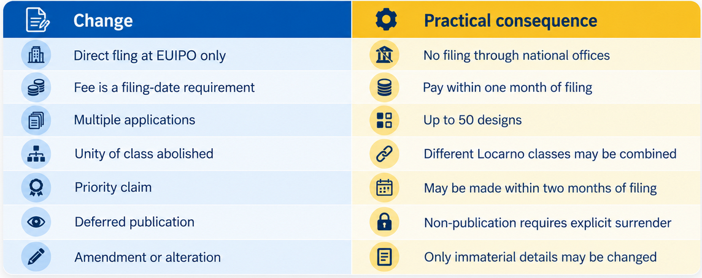
Applications: simpler, but new requirements
EU Design legislative reform
Notes:
Filing is more flexible, but there are several points that require docketing discipline. Applications are filed directly at EUIPO, and payment within one month is now relevant to securing the filing date.
Multiple applications can contain up to 50 designs, without the former unity-of-class restriction. This creates clear portfolio efficiencies, but each design remains legally separable and should still be assessed individually.
Priority may be claimed within two months after filing. For deferred designs, practitioners should also note that simply omitting a later publication payment is no longer a way to prevent publication. An explicit surrender is required.

Slide 19
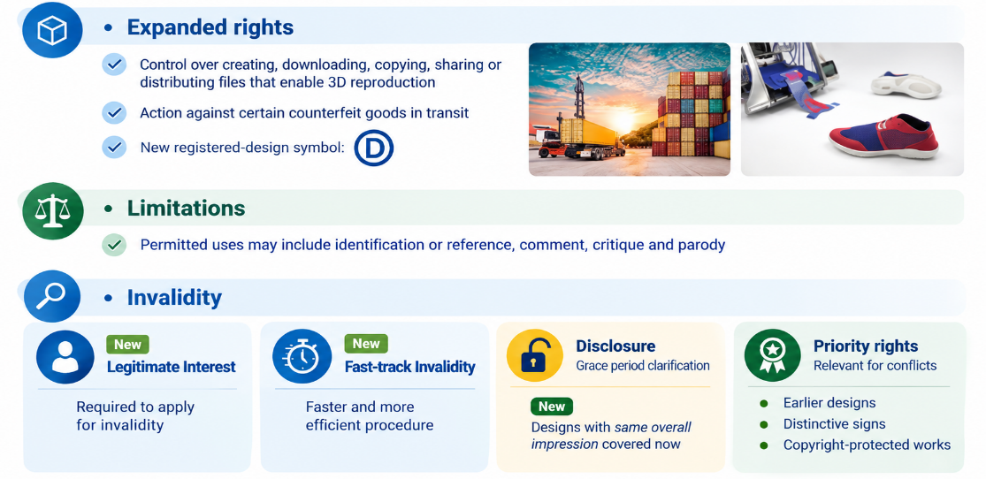
Rights, enforcement and invalidity
EU Design legislative reform
Notes:
The exclusive right now responds directly to digital manufacturing. It can cover creating, downloading, copying, sharing or distributing a medium or software that records the design for the purpose of making a product.
At the same time, the limitations are clearer, including certain uses for identification, reference, comment, critique or parody.
For contentious practitioners, invalidity applications now demand more front-loaded preparation. The invoked grounds, facts, evidence and arguments should be properly identified and supported at filing. Straightforward uncontested novelty or individual-character cases may be dealt with as a matter of priority, and final decisions can preclude later proceedings where the relevant identities are present

Slide 20
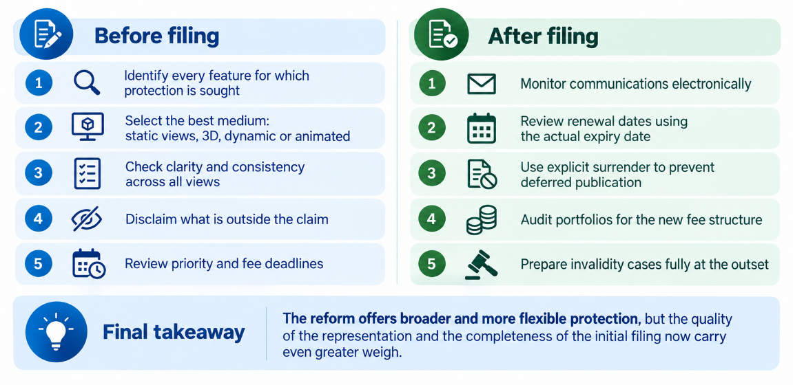
Practitioner checklist
EU Design legislative reform
Notes:
For practitioners, the reform can be reduced to three operational priorities.
First, settle the protection strategy before filing. The representation should capture every relevant visible feature and should use the most suitable format.
Second, update docketing and communication processes. Communications are electronic, the filing-fee deadline matters, and renewal periods are calculated by reference to the actual expiry date.
Third, front-load contentious work. Invalidity applications require a clearly reasoned case and the relevant supporting material from the outset.
The central message is simple: the system is broader, more digital and more flexible, but successful protection depends increasingly on precise representation and disciplined filing practice.

Slide 21


Slide 22
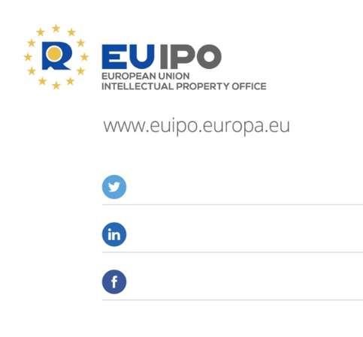

@EU_IPO
euipo
Sergio RIZZO
Boards of Appeal
EUIPO
EUIPO.eu
Thank you!

