Slide 1

Global assessment of the likelihood of confusion (LOC) between trade marks in cases where their similarity essentially resides in a weak or non-distinctive element
Flora Karamolegkou
Boards of Appeal –EUIPO
Seminar for IP Practitioners, Athens
5 October 2026
Notes:
a rather specific, but very practical, issue in the assessment of LOC: what happens when the similarity between two trade marks essentially comes from an element that is weakly distinctive or even non-distinctive?
The basic question is quite simple: if two marks have something in common, but what they have in common is weak, how much should that similarity really matter?
This question has generated quite a significant amount of case law, and, as we will see, the answer is not simply that weak elements can be ignored.
I will first briefly explain why the issue matters, then look at the Boards’ methodology, particularly concerning English terms, and finally look at the development of the case law and some very recent judgments.

Slide 2
Why the distinctive character of an overlapping element matters?
Factors for assessing similarity and the LOC under Art. 8(1)(b) EUTMR
Sabel, C-251/95: Similarity of signs based on the overall impression given by them considering their distinctive and dominant components; Identity/similarity of G&S; Level of public’s attention, inherent distinctiveness of the earlier mark as a whole; other factors relevant to the case.
Tension between two competing principles
Protection of the trade mark proprietor
Every validly registered mark must be protected (F1‑LIVE, C‑196/11 P). A component with weak distinctiveness cannot simply be disregarded. Nevertheless, the degree of its distinctiveness affects the extent of protection.
Freedom of competition
Descriptive and commonplace elements should remain available for other traders. Trade mark law should not create monopolies over weak (linguistic) elements.
Notes:
general framework.
Sabel: likelihood of confusion requires a global assessment. similarity of the signs, the similarity of the goods and services, the level of attention of the relevant public, the distinctive character of the earlier mark as a whole, and all the other relevant circumstances.
But when the similarity between the marks comes mainly from a weak element, there is a tension between two principles.
On the one hand, we have to protect the trade mark proprietor. F1-LIVE, a component cannot simply be disregarded because it has weak distinctive character. At the same time, the degree of distinctiveness affects the extent of protection.
On the other hand, there is freedom of competition. Descriptive and commonplace elements should remain available to other traders. Trade mark law should not give one undertaking an excessive monopoly over weak elements.
right balance: protecting the earlier mark without overprotecting the weak element that the marks happen to share.

Slide 3
Key Questions
What is a ‘weak element’?
Element possessing a low(er) degree of distinctive character.
(e.g. GIL medi for medical services, GIL bio for foodstuff, GIL shoes for footwear).
How to assess whether an element is weak?
In connection with the goods or services.
Relevant public’s understanding of the term in question.
Should LOC exist where the similarity of the signs resides in a weak element?
Trend - No LOC approach: a weak element has a limited impact in the assessment of the similarity between the marks.
How much weight that element should carry in the global assessment of likelihood of confusion?
Trend - No LOC approach: a weak element has a limited impact in the global assessment of the similarity between the marks.
Notes:
1. what do we mean by a weak element? Put simply, an element with a low degree of distinctive character.
2. how do we decide whether an element is weak? We do not assess it in the abstract. We assess it in relation to the relevant G/S and from the perspective of the relevant public.
3. Third, can there still be LOC when the similarity between the signs essentially resides in that weak element?
4. how much weight should that common weak element carry in the global assessment?
As we will see, the case law shows a clear no-LOC trend in these situations: the weak common element normally has limited impact. But this is a tendency, not an automatic rule.

Slide 4
General Principle: Knowledge of a foreign language by the relevant public must be proven by the party on whom the burden of proof rests.
Exceptions: English as a matter of common knowledge.
English is widely understood in some EU MS: English is understood in some MS; e.g. the Scandinavian countries, Finland, the Netherlands and Cyprus (T‑1154/23, Taxmarc / TAXMAN; T-253/20, It’s like milk but made for humans).
Basic vocabulary: Basic terms are understood throughout the EU. One indication is the CEFR level: A1/A2 words can be considered basic (T‑209/24, North 56‑4 / 66°NORTH; T-736/22, T-496/25 and T-497/25, MOOVA Almaviva GROUP/ MOOVIT).
Close linguistic equivalent: The English term has a close equivalent in the language of the non-English-speaking public (T-673/20, CÍCLIC (fig.) / Cyclic).
Recognition in the context of G&S: Professionals - familiar with sector-specific terms (IT, finance, electronics, telecoms, medicine (T‑301/09, CITIGATE; T‑513/13, SafeSet; T‑524/24, VC LAW (fig.) / vklaw). General Public - familiar with some through exposure, especially in entertainment, travel and tourism (T‑443/21, YOGA ALLIANCE INDIA INTERNATIONAL; T‑30/23, flyPersia (fig.) / flydubai)
Notes:
This brings us to a preliminary issue which is particularly important in the EU context: when can we assume that the relevant public understands an English word?
Knowledge of a foreign language cannot be presumed and must normally be proved by the party on whom the burden of proof rests. However, there are situations in which understanding of English may be regarded as a matter of common knowledge.
The Boards’ methodology identifies several indicators.
English is widely understood in certain Member States, such as the Scandinavian countries, Finland, the Netherlands and Cyprus.
We can look at whether the word belongs to basic English vocabulary. The CEFR level provides a useful indication here, and A1 or A2 words may be regarded as basic.
The English term may have a close linguistic equivalent in the language of the relevant public.
We look at the context of the G/S. Professionals may understand English terminology commonly used in their sector, while the general public may know certain terms through repeated exposure, for example in entertainment, travel or tourism.
So the essential point is: before saying that an English element is weak because of its meaning, we first need to establish whether the relevant public understands that meaning.

Slide 5
Why is this methodology important?
LOC does not need to exist throughout the entire EU. Because an EUTM has a unitary character and is protected throughout the EU, an opposition can succeed where a LOC exists in only a part of the EU, including a particular linguistic area.
If an English word appears in both marks, we need to determine which consumers in the EU will actually understand that word.
That understanding can affect the distinctiveness of individual elements, the comparison of the signs, and, ultimately, the assessment of likelihood of confusion.
Notes:
And why does this matter so much? Because LOC does not have to exist throughout the whole EU
.
Given the unitary character of the EUTM, LOC in only part of the EU — including a particular linguistic area — may be sufficient.
So, if an English word appears in both marks, we need to determine which consumers in the EU will actually understand that word.
If they understand it as descriptive or allusive, it may be weakly distinctive. If they do not understand it, the same element may have a different degree of distinctiveness.
And that can affect the comparison of the signs and, ultimately, the likelihood-of-confusion assessment.

Slide 6

Cases implementing the Boards of Appeal Methodology
11/06/2026, R 2596/2023-2, / SKYNET (appeal period pending)
‘SKY’ is a basic EN term (A2 level – beginner in CEFR). It will be understood by the public in the entire EU.
The common element ‘SKY’ is weak for services related to transportation. Its impact is limited in the comparison of the marks. The signs are visually, phonetically, conceptually similar to a low degree.
► No LoC for the contested Cl. 39 services.
29/05/2026, R 1921/2025‑4, wonderjeans / W wonders (appeal period pending)
‘Wonder’ (B1 level) is not a basic EN term and will not be understood in Bulgaria, Spain and Italy.
Signs are visually similar to an above average degree, aurally similar to a high degree and conceptually not similar. The signs coincide in their most distinctive elements, namely the term ‘wonderʼ and have a similar structure.
► LoC for non-English-speaking public in relation to Cl. 25 goods.
Notes:
Let me illustrate this with two recent Board decisions which produce contrasting results.
In the SKY case, the Board considered ‘sky’ to be a basic English word at A2 level and therefore understood throughout the EU. For transportation-related services, SKY was weak. So although the marks shared that element, its impact on the comparison was limited. The result was no likelihood of confusion for the contested Class 39 services.
Now compare this with WONDER, which for English speaking consumer could be considered as laudatory praising the characteristics of the goods. ‘Wonder’ is classified at B1 level, so it was not treated as basic English vocabulary. The Board considered that it would not be understood by the public in Bulgaria, Spain and Italy.
For that public, the signs therefore coincided in their most distinctive element, ‘wonder’, and also had a similar structure. This time, the result was likelihood of confusion for the non-English-speaking public in relation to Class 25 goods.
So the contrast is useful: understanding affects distinctiveness; distinctiveness affects the weight of the common element; and that can affect the final outcome.

Slide 7
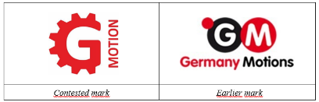
Cases implementing the Boards of Appeal Methodology
01/04/2025, R 1752/2024‑1, (confirmed by T-349/25; further appeal pending before the CJEU C-692/26)
‘MOTION’ (C2 level) is understood EU-wide by the relevant public consisting of professionals for goods such as machines, engines and motors.
Professionals usually have a basic command of the English terms used in their industry.
‘MOTION’ will be non-distinctive for the relevant professional public.
The signs are visually and conceptually similar only to a low degree and aurally similar to an average degree.
► No LoC for the relevant professional public in relation to Cl. 7 goods
Notes:
The next case illustrates the importance of looking not only at the vocabulary level, but also at who the relevant public is.
The common element here was MOTION. The relevant public for machines, engines and motors consisted of professional users.
Interestingly, ‘motion’ is classified at C2 level. Nevertheless, the Board considered that the relevant professional public throughout the EU would understand it, because professionals generally have a basic command of the English terminology used in their industry.
As a result, MOTION was considered non-distinctive for that public. The signs were visually and conceptually similar only to a low degree and aurally similar to an average degree, and ultimately there was no likelihood of confusion for the relevant Class 7 goods.
So the CEFR level is useful, but it is not the end of the analysis. We also need to consider the relevant public and the commercial context.

Slide 8
Recent case-law: 09/09/2026, T‑495/25, MOOVA ALMAVIVA GROUP (fig.) / MOOVIT
GC’s approval of the methodology!
‘The English words ‘move’ and ‘it’ must be regarded as forming part of basic English vocabulary. Those two words are classified in the Oxford Learner’s Dictionary in Category A1/A2 corresponding to the basic level of English in accordance with the Common European Framework of Reference for Languages (CEFR) (§ 65)
The element ‘moov’ is evocative of the G&S in Cl. 9 and 42 in the mobility sector (software related to transportation) and has a weak distinctive character.
► No LOC for all the relevant consumers in the EU.
Notes:
And this brings us to a very recent GC judgment from September 2026: MOOVA ALMAVIVA GROUP against MOOVIT in which the GC approved the methodology.
GC considered that the English words ‘move’ and ‘it’ form part of basic English vocabulary, referring expressly to their A1/A2 classification in the Oxford Learner’s Dictionary and the CEFR.
It then considered ‘moov’, evoking ‘move’, to be weakly distinctive for software relating to transportation and mobility in Classes 9 and 42.
The final result was no LOC for all the relevant consumers in the EU. So this is important confirmation, at GC level, of the methodology used to assess understanding of basic English terms.

Slide 9
The No-LoC tren in the EU case law
12/06/2019, C-705/17, ROSLAGSÖL (Hansson)
Weak elements of complex signs generally have less weight in the analysis of the similarity between the signs than elements of a greater distinctiveness, which are also more able to dominate the overall impression created by the mark (§ 53).
Where the signs overlap in a weak element, the global assessment of the likelihood of confusion will rarely lead to a finding that that likelihood exists. Nevertheless, a finding that it exists cannot be ruled out in advance and in any event without an assessment of the specific circumstances of the case (§ 55).
18/06/2020, C-702/18 P, PRIMART Marek Łukasiewicz (fig.) / PRIMA,
Where the earlier mark and the contested sign coincide in an element that is weakly distinctive in relation to the G&S, the global assessment of the LOC does not often lead to a finding that such likelihood exist.
05/10/2020, T-602/19, NATURANOVE / NATURALIUM
The distinctive character of the earlier mark must be regarded as being of decisive importance. With regard to a trade mark with a weak distinctive character, and which thus has a lesser capacity to identify the G&S for which it has been registered as coming from a particular undertaking, the degree of similarity between the signs should be high to justify a LOC, or this would risk granting excessive protection (§ 56).
Notes:
Let me now step back from the language methodology and look at the broader case-law trend.
In ROSLAGSÖL, the Court stated that weak elements of complex signs generally have less weight in the comparison than elements with greater distinctiveness. More importantly, it said that where the signs overlap in a weak element, the global assessment will rarely lead to a finding of likelihood of confusion.
But the word ‘rarely’ is important. It does not mean never. The Court expressly says that likelihood of confusion cannot be ruled out in advance without assessing the specific circumstances of the case.
PRIMART follows the same approach: where the marks coincide in a weakly distinctive element, the global assessment does not often lead to likelihood of confusion.
And NATURANOVE explains the underlying concern. Where the earlier mark has weak distinctive character, a high degree of similarity between the signs may be required to justify likelihood of confusion; otherwise, we risk granting excessive protection.
So the emerging principle is balanced: the weak common element is not ignored, but normally it should have limited weight.

Slide 10
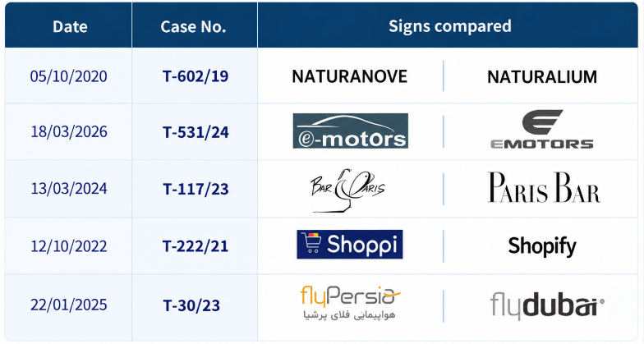
More cases following this trend
Notes:
This slide shows that this was not an isolated development. A significant number of subsequent cases have followed the same approach.
I will not go through them individually. The point is the overall pattern: where the marks coincide essentially in an element which is weak or non-distinctive, that coincidence is normally given limited weight, particularly where the signs contain other elements capable of distinguishing them.
But the cautious language remains important. No likelihood of confusion is not an automatic consequence of a weak common element. Everything still depends on the overall configuration of the marks and the circumstances of the particular case.
And that brings us to two very recent judgments which illustrate precisely that qualification.

Slide 11
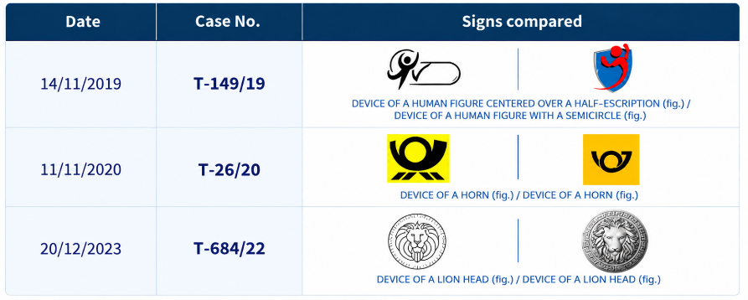
Notes:
I will use this slide simply as a transition. The recent case law shows that the no-LOC trend is strong, but it does not remove the need to assess which elements actually dominate the overall impression of the signs.
The next two judgments are useful because they show how a weak element can nevertheless become decisive in a particular configuration.

Slide 12
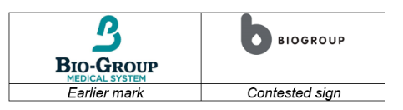
08/07/2026, T‑309/25, BIO-GROUP MEDICAL SYSTEM (fig.) / BIOGROUP (fig.) et al.
GC confirms that ‘BIOGROUP’ is weak but states that the BoA should have found it dominant.
‘Biogroup’ is more memorable because it stands out by its length, size, central position and dark colour, and is the only word element in the earlier mark.
‘Biogroup’/‘bio-group’ dominated the overall impression, as consumers more readily refer to goods by name than by describing figurative elements.
The fact that the marks consist exclusively of weak elements is not sufficient to rule out the possibility that one of those elements may dominate the other elements.
The error in the dominant character of ‘BIOGROUP’ impacts the visual and phonetic similarity, and consequently, the global assessment.
► LOC
Notes:
This case is particularly interesting because the GC accepted that BIOGROUP was weak, but nevertheless considered that the Board should have found it dominant.
Why? Because ‘Biogroup’ stood out due to its length, size, central position and dark colour, and it was the only word element in the earlier mark. The Court also recalled that consumers more readily refer to goods by name than by describing figurative elements.
This gives us an important qualification to the no-LOC trend: weak does not necessarily mean non-dominant. The fact that the marks consist exclusively of weak elements is not sufficient to rule out the possibility that one of those elements dominates the others.
Here, the error concerning dominance affected the visual and phonetic comparison and, consequently, the global assessment. The result was likelihood of confusion.

Slide 13
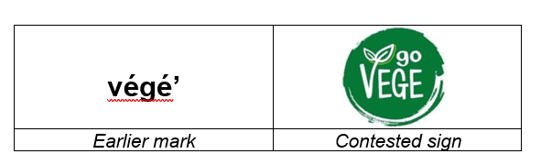
15/07/2026, T‑677/25,’ go VEGE (fig.) / végé’
  The figurative elements are merely decorative, and their differences should be minimised.
  The weakly distinctive, smaller ‘go’ is unlikely to attract attention, so ‘végé’ dominates the overall impression.
  ► LOC
Notes:
We see a similar point in go VEGE against végé, also from July 2026.
Here, the figurative elements were considered essentially decorative, so the differences created by them had limited importance.
At the same time, the smaller element ‘go’ was weakly distinctive and unlikely to attract much attention. As a result, ‘végé’ dominated the overall impression. Again, the result was LOC.
These two recent judgments remind us why the cautious wording used by the Courts is important. A weak common element will generally have less weight and will rarely lead to likelihood of confusion — but there are configurations in which a weak element can nevertheless play a decisive role.

Slide 14
Takeaways and questions
A term’s meaning depends on the relevant public and its language(s) in the EUTM context.
Procedural point: opponents/ invalidity applicants should challenge findings that common elements are of weak distinctiveness.
GC and CJEU use cautious language: (“generally”, “will rarely lead to the findings of a LOC”, “does not often lead to a LOC”, etc.).
No factor operates in isolation: LOC requires a global assessment and interdependence of all relevant factors.
Case-by-case analysis remains essential: do not overlook the other, particularly figurative, elements of the signs.
Notes:
First, the meaning and distinctiveness of an element depend on the relevant public, its language or languages, and the goods and services concerned. Particularly with English terms, we first need to establish whether the relevant public actually understands the term.
Second, there is also a procedural point. If an opponent or invalidity applicant disagrees with a finding that the common element is weak, that finding needs to be challenged. It can shape the entire subsequent comparison.
Third, notice the cautious language used by the General Court and the Court of Justice: ‘generally’, ‘rarely’, ‘does not often’. These are principles guiding the global assessment, not automatic rules.
And finally, no factor operates in isolation. We still have to apply the principle of interdependence and assess the case as a whole, including the other — and particularly the figurative — elements of the signs.

Slide 15
Takeaways and questions
Where the common element is weak, a high degree of similarity between the signs may be required to establish LOC (NATURANOVE / NATURALIUM, T-602/19).
“Dominant” ≠ merely eye-catching: ask whether the element is simply visually striking or whether it actually dominates the overall impression and is likely to be remembered.
Keep the two stages distinct: dominance matters first in the comparison of the signs, and then within the global assessment of LOC.
A weak element may still be dominant, but dominance does not automatically establish LOC—creating a degree of uncertainty that must be resolved through the overall assessment.
Bottom line: the analysis requires a careful balance between distinctiveness, dominance, similarity and the overall impression of the signs.
Notes:
The final point is the relationship between distinctiveness and dominance.
Where the common element is weak, NATURANOVE tells us that a high degree of similarity between the signs may be required before likelihood of confusion can be established.
But ‘dominant’ does not simply mean eye-catching. The question is whether the element actually dominates the overall impression and is likely to be remembered by the consumer.
And we should keep the two stages distinct. Dominance matters first when we compare the signs. We then move to the global assessment of likelihood of confusion, where all relevant factors must be considered together.
So a weak element may still be dominant, as BIOGROUP shows. But dominance does not automatically establish likelihood of confusion either.
If I had to summarise the case law in one sentence, it would be this: a weak common element should normally have limited weight, but it must never be assessed in isolation. Distinctiveness, dominance, similarity and the overall impression of the signs must all be considered together.
We need to provide effective protection to registered trade marks while, at the same time, avoiding excessive protection of descriptive, commonplace or otherwise weak elements.
The case law increasingly provides us with a framework for achieving that balance, but, as the most recent judgments show, the assessment remains highly dependent on the circumstances of each individual case.

Slide 16
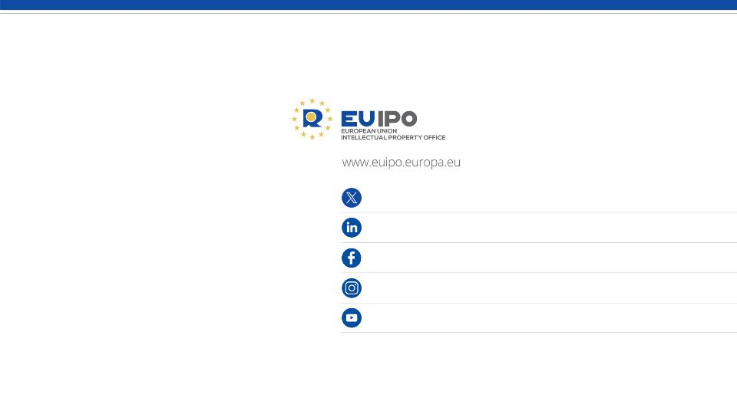
@EU_IPO
euipo
EUIPO.eu
@euipo
EUIPO
THANK YOU !

